Slide 1
Second to whom? Second generation of young women between citizenship and politics
MWP Second Transnational Workshop, Athens 2-5 June 2014
Activities undertaken within the project and outcomes of EP elections in Italy

Slide 2
Outcomes of EP election in Italy

Slide 3
Political Party | Percentage of votes taken | Number of elected | Number and Percentage of women elected
Partito Democratico (PD) | 40,81 % | 31 | 14 45,1 %
Movimento 5 Stelle (M5S) | 21, 15 % | 17 | 9 52,9 %
Forza Italia | 16,82 % | 13 | 4 30,7 %
Lega Nord | 6,15 % | 5 | 0
NCD | 4,38 % | 3 | 0
L’Altra Europa con Tsipras | 4,30 % | 3 | 2 66,6 %
Südtiroler Volkspartei | 0,5 % | 1 | 0
Total |  | 73 | 29 39, 7 %

Slide 4
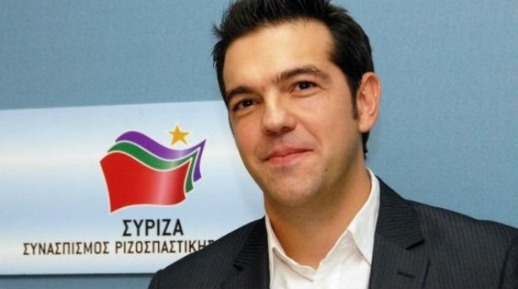
What about SEL?
Candidate for the presidency of the European Parliament

Slide 5
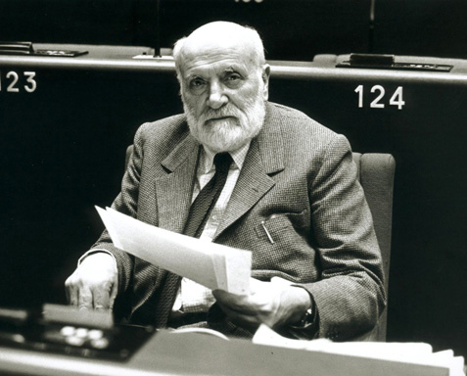
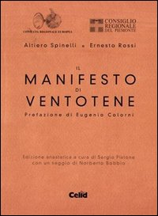
Barbara Spinelli
Subtitle Text: For a free and united Europe.
This a document for the promotion of European unity drafted by three antifascist: Spinelli, Ernesto Rossi and Eugenio Colorni, during the period of confinement in the forties, at the island of Ventotene, in southern Lazio, b the fascist regime.
Altiero Spinelli

Slide 6
What has changed since 2009 EP in term of gender equality, for Italy?

Slide 7
2013- More women in italian politics!

Slide 8
Cecile Kyenge Minister of International Cooperation and Integration
Subject to heavy racial slurs, even by LEGA NORD (Political Party), who is very xenophobic and racist part of italian politics

Slide 9
The question for italian LAG
From 2006 to 2010, 650,802 children was born in Italy by foreign family origins.
Half of these are girls.
According to the italian law of citizenship, very restrictive and reactionary, these girls can’t vote and be voted.
Most of them are not considered like «italian citizens».
They cannot take part of political life.

Slide 10
Activities of italian LAG
Organization of Event before EP election to support women candidates.
Creation of a video-documentary in which have been interviewed “italian” women and second generation’s women (women who are daughters of foreign parents) already engaged in national politics, candidates at EP election of May or activist in political movements, asking them about what is the importance of women in politics.
Preparation of several audio-interviews in which we interviewed “italian” women and second generation’s women, asking them on their relationship with politics and society as women.
Creation of official website “Second to whom?”
Making of two Workshop at the schools (January 2014-Mars 2014) with girls and boys about the issue of citizenship of second generation’s man and women.

Slide 11
Women support women. Why?
It is sufficient to be a women to create a shift and a transformation in the structure of policy and society?
An equal number of men and women in the institutions of national and international policy is sufficient so that we can speak of "gender equality"?

Slide 12
Francesca Koch
President of the International House of Women in Rome
Elettra Deiana
Responsible political SEL for MWP project.
Celeste Costantino
Deputy of SEL at Italian Parliament
Bianca Pomeranzi
Expert in European law, international and gender issues

Slide 13
Issues discussed
How does International Home of Women in Rome supports the participation of women in politics?
What is the specific contribution that women bring to politics? As the political parties should take steps to raise awareness among women to vote for women?
Why the presence of women in international politics is essential to transform mode and content of it?
Is it enough to be a women to produce a shift in Italian politics?

Slide 14
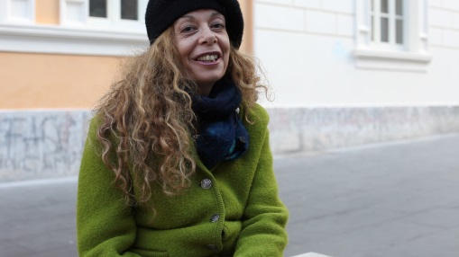
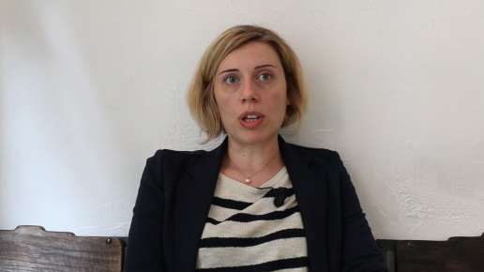
Video-documentary 1. The Protagonists
Eleonora Forenza
Researcher, Member of F9 – Feminist collective.
Candidate at EP election with L’ Altra Europa con Tsipras
Loredana Lipperini
Journalist, Writer, Radio host.
Candidate at EP election with L’Altra Europa con Tsipras
Celeste Costantino
Activist for women rights.
Member to the Chamber of Deputies on Italian Parliament.

Slide 15
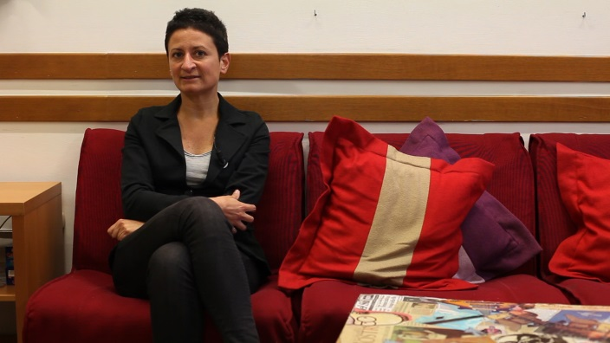
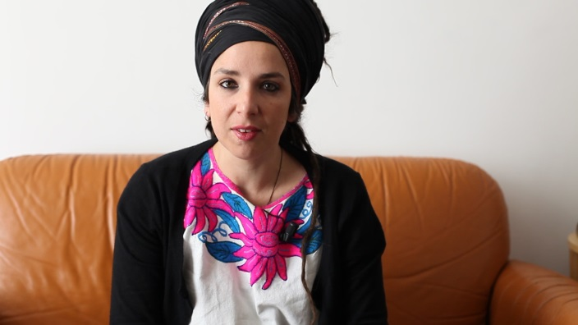
Maya Ciana
Activist G2 (Second generation’s boys and girls)
Marta Bonafori
Regional Councillor in the group «for Lazio» (italian region in which there is Rome)
Marica Di Pierri
Activist and Journalist.
Leader of communication area, Association «A Sud»

Slide 16
What about women in politics?
What reasons did you push to enter politics?
What are the barriers you have encountered in the development of your political career?
What is your area of interest in political?
What tips would you give to women who want to engage in politics to advance their ambitions?
Do you think that the contribution of women in politics is important? If so, why?

Slide 17
Audio-interviews
Identity, citizenship and belonging
Interest and cultural consumption
Transnational crossings
forms of participation in the public sphere and political
forms of participation in civil society movements
Perception of the importance of gender equality in politics

Slide 18
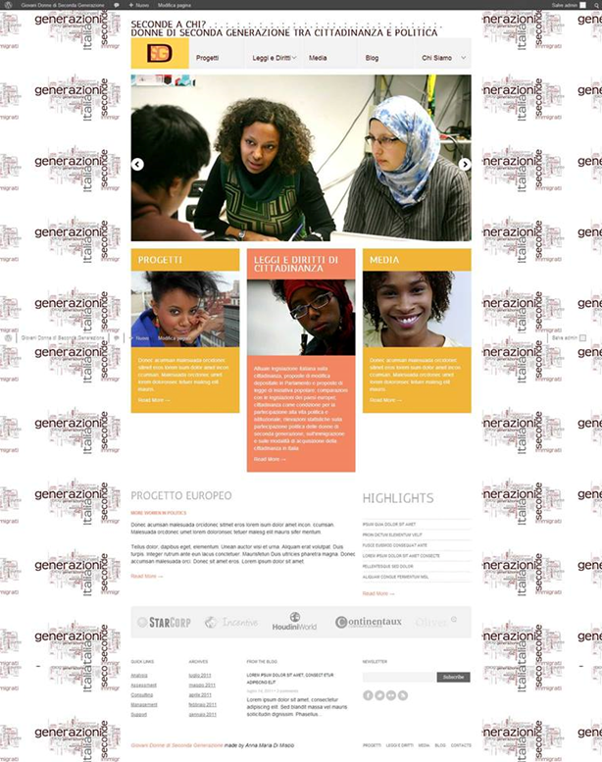
Official website

Slide 19
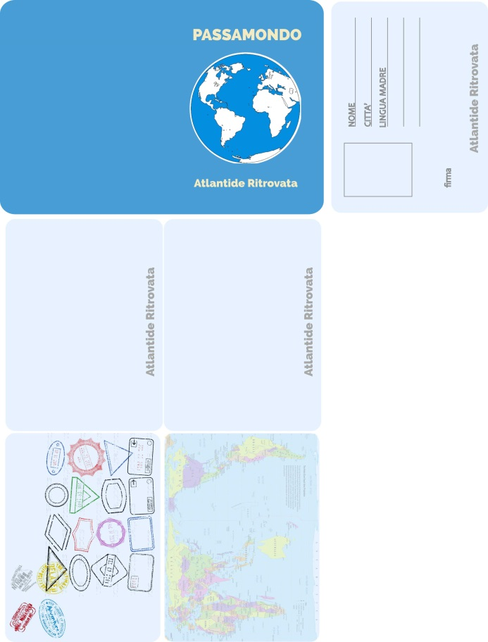
Workshop in schools
Workshop in three high schools (16-18 aged)
«Passamondo. The Atlantis refound?»

Slide 20
The importance of these Workshops
Addressing the issue of gender equality in politics with the boys and girls in age to the next vote.
Addressing the issue of citizenship rights and cultural and legal barriers that prevent many Italians to vote.
Working actively in the formation of a political consciousness multicultural and sensitive to gender equality from the new generations, or from possible future Italian political class.
Encourage the participation of young women in politics.

Slide 21
No politics, without women!

