Slide 1
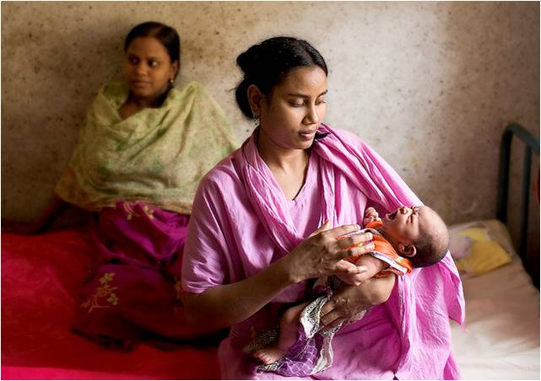
Pre & Post Maternity Services for Migrant Women
Presentation by Monica Tolofari
Consultant Midwife in Public Health
11th November 2010

Slide 2
Background
Population – Diverse & mobile 70% BME
80% of households are Asian families, living in semi-detached houses, private rented terraced accommodation and social housing.
2/3rds of residents live in the most deprived neighbourhoods (worst 20%) in the UK
Access to green space poor. 6% of land is green space
Health of our residents in Birmingham has improved
Fewer babies die now compared to five years ago
However our population still has poor health compared to other parts of Birmingham and UK

Slide 3
32% of our population (87,900) are children and young people (under 19 years) Expected to increase in the next 5 years to 22,000
Migration
People have migrated from all over the world and settled in Birmingham with Aston being the place to go before settling elsewhere in Birmingham

Slide 4
Maternity Care in UK
Genetic counselling
PCT’s SHA’s
Family nurse partnerships
Doula’s
Midwifery Led units (MLU). Stand alone & alongside – low risk
Children centres
Voluntary sector
Hospital Consultant Obstetrician Led Units – High risk
Statutory Midwifery Supervision
Water births
Home Birth
Pregnancy Fast track Pharmacy scheme & Midwifery project
General practitioner (GP)
Social services
POW support Elsips Trial
Family support
Parentcraft workshops

Slide 5
Key Challenges/Barriers
Antenatal
Late booking for antenatal care – quarter of the Trusts in the UK have 26% of women that book late
Large midwifery caseloads
Traditional 15 minute antenatal appointments too short for needs of women who have complex needs and language difficulties
Access to antenatal care – understanding how to negotiate maternity services in the UK

Slide 6
Key Challenges/Barriers
Continuity of carer – focus now on continuity of care and standards of care
Smoking cessation – White European women - 34% smoking at delivery
Breastfeeding – 49 - 61% amongst Pakistani, Bangladeshi & white British
Early detection of Intrauterine growth restriction (IUGR)
Timely USS - Scanning in the community & hospital
Infant Mortality 2008/9 the rate 7.7 per 1000 live births in HOBtPCT area it was 9.1 in 2007 (49 babies died in first year of life)
Congenital malformations (Consanguinity - marriage to close relative – recessive gene disorders)
Poverty – destitution - social need social exclusion
Language – barrier to accessing services
Mental health
High Caesarian Section rate – WHO recommends 15%

Slide 7
HOBtPCT and England and Wales Infant Mortality Rates 2002 -2009
Deaths per 1,000

Slide 8
Conclusion Risk assessing both medically & socially Smaller caseloads for midwives who have women with complex needs (NICE 2010) Moving away from the traditional model of care to have services that embrace migrant women & their families. Deliver care in a way that accommodates individual need. One size or time does not always fit all. Acknowledging the need for longer AN appointments for some women Act on poverty, use other agencies POW, Family support Reference – NICE (2010) Pregnancy & complex social factors: A model for service provision for women with complex social factors. [Online] www.nice.org

Slide 9
Conclusion continued
Preconceptual care GP’s hold the key as women generally go to their GP to access maternity services despite being told they can access maternity in other ways
Family nurse partnerships have already shown that they are impacting breastfeeding rates and smoking cessation rates in a positive way
Reduce midwife case loads –
Education of Midwives & Doctors re migrant womens needs
Social marketing – getting women to engage with maternity services and making maternity services relevant & flexible for women
Access - Early & ease of access - provide affordable transport to clinics. Provide flexibility in service provision –’drop ins’ . Fast track HUB if clinic full send to next available clinic

Slide 10
Thank you for listening

