Slide 1
The Prince’s Trust
supporting young entrepreneurs
Notes:
Introduce myself and thank the organisers for the opportunity to meet so many interesting people from across Europe

Slide 2
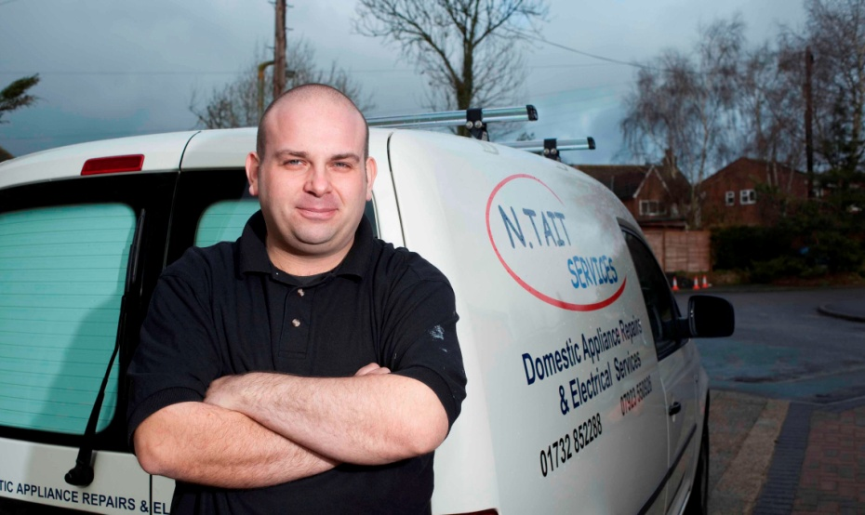
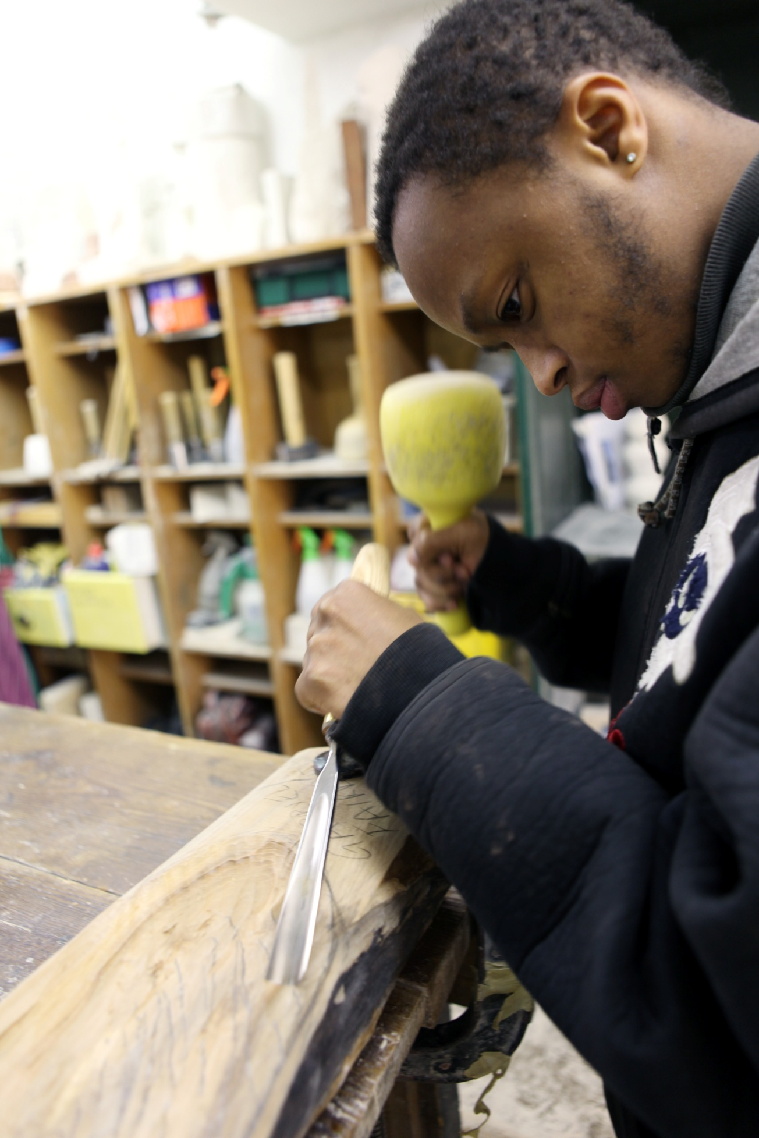
Overview
Setting the UK context
The scale of need
UK government response
Overview of The Prince’s Trust
The Enterprise programme
Support
Results
Questions

Slide 3
The scale of need
Unemployment amongst young people under 25 years old is now over 20 per cent
Over one million young people are not in work, education or training
One in six children lives in a household with no income from work
Youth unemployment is estimated to cost up to £155 million per week in terms of benefit payments and lost productivity
Total cost of youth crime is calculated at £1.2 billion each year
Notes:
UK youth unemployment – highest since early 1980s.
result of the recent economic downturn, is a spike at the end of a long-term trend, rather than a surge from nowhere. Youth unemployment began to rise significantly in 2005, before the recession hit.
Although youth unemployment is not a problem confined to the UK, the increase in the number of those 16-24 year olds classed as unemployed in the UK
more of a youth problem - as, throughout the recession, outstripped most other OECD countries.
unemployment rate for 16-24 year is one in five, the rate of unemployment for 50-65 year olds only reached 5.1 per cent, and those over 60 years old actually increased their employment rates.
If current economic trends continue on the same trajectory, we should expect 20% unemployment for 16–24-year-olds to become the new norm.
Those affected:
During this time the gap between the employment levels of those with no qualifications or low qualifications (below level 2), compared to those with higher qualifications (level 2 or above) has widened.
The Bank of England reports that almost 90% of the employment growth during the recent decade of economic prosperity was for people with degree-level qualifications.
The UK has one of the lowest levels of social mobility in the OECD. There are currently many barriers throughout the life cycle which prevent disadvantaged young people from climbing the economic and social ladder, and reaching their potential.
Self employment is obviously a key route by which young people can break the constraints of social and economic disadvantage. For example, whereas employers value high educational attainment and high quality work experience (opportunities which are often limited to better-off), disadvantaged young people have often become successful entrepreneurs based on a good idea and determination.)

Slide 4
The UK government response
‘The year of enterprise’
CDFIs
Regional Growth Fund
Big Society Capital
New Enterprise Allowance
Notes:
What are the UK government doing?
Mark Prisk, Minister for Business, Innovation and Skills, January 2012:
“We want 2012 to be the year of enterprise, where entrepreneurs can unlock their business potential. We need to make sure people know that there is support and advice available, that it is easy to get, and it is often on their doorstep. The Government is committed to providing more opportunities for businesses to start and grow. We are continuing to increase the number of volunteers through the new national mentoring scheme and have launched an improved business link website.”
David Cameron PM, frequent talk of cutting back bureaucracy for SMEs and extra support for entrepreneurs....
The New Enterprise Allowance which offers access to mentors for young people who have been unemployed for 6 months or more (claiming JSA) wishing to develop a business plan and move towards launching their own business. Once trading they can claim a weekly allowance for up to 26 weeks, and loan finance to help with start-up costs.
In addition young people can access Enterprise Clubs in their local area, run by groups and organisations to promote entrepreneurship and give additional advice and guidance to attendees;
Helping young people find sources of funding by continuing to support Community Development Finance Institutions (CDFIs) which are independent financial institutions, who lend to those who have been turned down by banks;
The Regional Growth Fund, which has approved, subject to due diligence, a contribution of £30 million to a new £60 million wholesale fund for organisations that make loans to entrepreneurs, start-ups and SMEs, particularly in disadvantaged groups and communities. This is the biggest fund of its kind in the UK; and
Big Society Capital (formerly the Big Society Bank), which will soon begin investing in social enterprises. This could include investing in CDFIs and Enterprise Agencies that provide business advice, training, mentoring and loans to entrepreneurs, start-ups and SMEs, again focused on deprived groups and communities.

Slide 5
The Prince’s Trust programmes
Enterprise programme – our business start-up programme
Team – three-month personal development programme
Get into – short vocational courses e.g. Get into Cooking
Get Started – flexible short personal programmes
xl clubs– a pioneering and transformative in-school education programme
Community Cash Awards – cash awards up for projects that will benefit their local community
Development Awards – cash awards for young people to access education, training or work
Fairbridge – Fairbridge have centres in 15 of the most disadvantaged areas of the UK
Notes:
The Trust was created by HRH The Prince of Wales – he used his Royal Navy pension to set up a number of community projects to benefit disadvantaged young people. – 35th anniversary in 2011
Our Vision - Every young person should have the chance to succeed
Our Mission - To help disadvantaged young people in the UK to change their lives and get into employment, education or training
Employability and Skills
“Young people want to work. Those from disadvantaged backgrounds need more help to build the social networks, confidence and qualifications to be able to move towards a job. We offer programmes that motivate young people and help them progress into education, training and employment. Our relationship with employers means we are a realistic bridge between what young people want to achieve and the job market, giving them the personal skills they need to get a job.”
We believe that every young person, no matter what their background, has the potential to succeed and build a better future for themselves.
We help the young people on our programmes to get the skills, qualifications and experience they need to go on to get a job or go into further education, training or volunteering.
Last year The Trust helped over 46,000 young people, this year 50,000, next year 55,000?? To do this, we need to raise at least £50 million per year

Slide 6
The Prince’s Trust Enterprise Programme
Supports young people to:
explore a business idea and decide whether self-employment is right for them
test, plan and start a business or achieve goals in education, training, employment or volunteering
Who is it for?
Young people aged 18-30 in the UK
Unemployed or working fewer than 16 hours a week
Have a business idea they would like help to explore
Notes:
The Enterprise Programme supports young people to explore a business idea and decide whether self-employment is right for them.
The programme can support young people to test, plan and start a business or to achieve goals in education, training, employment or volunteering.
Who is it for?
Young people aged 18-30 in the UK
[In Scotland we run a joint operation with our sister charity, Prince’s Scottish Youth Business Trust]
Unemployed or working fewer than 16 hours a week, and
Have a business idea they would like help to explore

Slide 7
The Enterprising journey
Inspire
Use enterprise as a hook to engage
Support to work out what it means for them
Facilitate short and long term action planning
Explore
Support YP to explore and test their ideas and make decisions
Remove financial barriers
Teach key concepts and skills
Inspire
Explore
Boost
Launch
Launch
Achieve enterprising outcomes
Start viable and sustainable businesses
Use start up resources carefully
Boost
Mentoring
Specialist support
Alumni scheme for continued growth and networking
Notes:
4 key themes outline how we move a young person through the programme

Slide 8
How does it work?
20 young people
£185 average
10 engagements
Mentoring
WIW
?
Progression
Employment
Outcome
s
Education & Training
Info session
Explore Enterprise
Next steps
?
Volunteering
Qual
Distance Travelled
Plan
Business
Business Launch Group
Money
Mentoring
Approx. 8hrs each
Notes:
Information Session
A one hour group session to tell young people about the programme, its purpose and the support on offer, as well as what The Trust needs from the young people who take part. This allows the young people to decide whether the programme is for them and whether they have the commitment and motivation needed to take part.
Explore Enterprise
Four consecutive days to learn about topics relevant to planning and running a business and to consider whether self-employment is right for them. It is designed to be practical, interactive, visual and based around discussions and activities. It aims to enable young people to feel what running their own business would be like and what it would involve, whilst teaching some of the most relevant knowledge and concepts.
--- Enhance YP’s knowledge, skills and motivation
Next Steps Sessions
On average, eight hours of one-to-one support to help think through, choose and plan their next step and outcome. For young people who need financial support to test their ideas, Will it Work grants (of up to £250 per young person) can be provided to help them. The sessions can be booked on days, times and at a frequency that suit the young people.
---Enhancing business viability: test quality of business idea, prove markets and provide flexible support to help make informed decisions
Best Foot Forward
Young people are offered either progression mentoring for up to six months or business mentoring for two years depending on their chosen outcome. For Trust supported businesses that really need it, financial support is also available. To apply young people present their business propositions to a Business Launch Group, who recommend whether to offer support.

Slide 9
Benefits
Helps them to choose the goal that is right for them
Gives them lots of practical support to make decisions
Helps them to meet other young people who also want to change their lives in a positive way
Flexible timetable of support
Individual and unique – nobody else is offering anything like it
Various opportunities for volunteers
Quality lending decisions and increased chance of business success
Measure success based on what it means to individual young people (self-employment plus other employment / education / training)
Notes:
The new Enterprise programme model is meeting the needs of YP very well. Here are a few benefits of the new approach...

Slide 10
Performance 2010 / 11
Cost: £1900 per young person
5,676 young people last year
What young people tell us after the programme...
88 per cent in self-employment, employment, education, training or volunteering
68 per cent self-employed
34 per cent employed
9 per cent in education or training
2 per cent doing voluntary work
Notes:
£1,900 average cost per YP. Includes:
supporting volunteers, training costs, materials, venues, travel, additional assistance e.g. childcare
Will it Work grants
Cost of business loans and Equifax reports / administration
Programme and regional staff
Office costs, marketing, publicity, evaluation, etc.
Participation is counted when a young person has attended day two of the EEC – shows commitment. On track to do the same number of YP this year– 5670. growth next year?
Outcomes taken from text survey after 3 and 12 months.
Positive outcomes slightly lower so far this year due to jobs market suffering (84% currently)
Not all these young people start up businesses with our support – some leave the programme early
Outcome data: This is a percentage of all starters (i.e. those counted in the participation numbers) 3 and 6 months after their end date (or 12m after business start).

Slide 11
Performance 10/11: Business starts and lending
The Trust started 1,156 new businesses (approx. 1 in 5 YP)
The Trust works with 3,000 business mentors to support start-ups
57 per cent business survivability over 2 years (62 per cent this year so far)
Average start-up loan £2,747
Loans Collection team now collect 64 per cent of loans (up 52 per cent last)
Notes:
We start up 1 in 5 of our young people in business with help with their business plans, mentoring and possibly funding... but 68% tell us after the programme that they are self-employed so many more are setting up businesses of their own accord, without the need for this help.
Includes all types of businesses from mobile mechanics, to hairdressers, to shops and cafes and everything in between.
Business survivability at 62% so far this year
Professional in–house Loans Collection team –together we work to support the quality of lending decisions and repayments, using a young person friendly approach and a sliding scale of arrears.

Slide 12
What do young people think?
Explore Enterprise
‘Very inspiring to hear from someone who has been through the whole process.’ Hayley
‘I only have good things to say...learnt and improved skills. I feel less lonely and feel more confident!’ Jennie
Will it Work grants
‘I had a Will it Work grant to test my bridal business idea. My business idea hasn’t changed. But how I market my business will change I'm going to add to my website, collate more literature for giving out at exhibitions. I'd plan to do more in advance & make sure I don't leave things to the last minute.’ Elli
Outcomes
‘The whole process is a big learning curve. I’ve learned about finances, how to be careful with money, what works for business and what doesn’t. I really believe that this last year has taught me more about business and life then any other’ Cezary

Slide 13
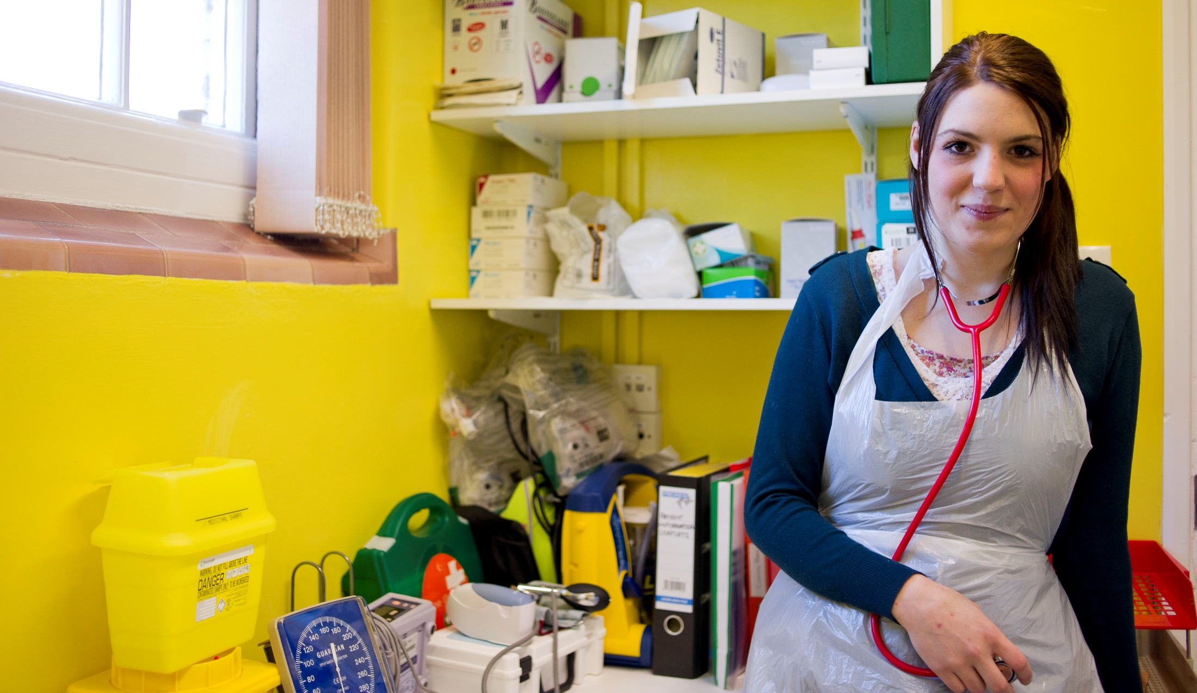
Beyond the Enterprise programme... The future for our young people
Enterprise Network
Young Ambassadors
Enterprise fellows and future business leaders?
Notes:
Over 550 members of the network – only running for 1 year so far
Opportunity for our young people that want to give back to volunteer for 1 year to help us fundraise, consult on decisions and recruit / inspire new young people as inspirational speakers.
Also lots of volunteering roles they can go for – e.g. On the Business Launch Group or as business mentors, when they have enough experience
Enterprise Fellowship – a scheme for experienced business people to donate and give back their time
One PT-supported business just donated £250,000! Contraband International Ltd, Archie Archer, supported by PT, she started with a market stall in London, now an international import export business with its own factory in Delhi, supplying to Topshop, Miss Selfridge and many other high street chains, which has now grown to include entertainment – from belly dancers to graffiti artists!

Slide 14
The future of the Enterprise programme
Review of accessibility
Accreditation pilot
Further improvements to lending decisions
Develop and enhance progression mentoring for those pursuing alternative outcomes

Slide 15
Thank you for listening
For more information please visit princes-trust.org.uk
Laura Wyatt-Smith
National Head of Programme
laura.wyatt-smith@princes-trust.org.uk
020 7543 1212
Notes:
Any questions?

