Slide 1
Creative incubator & business centre

Slide 2
Program
Background History, purpose and vision of the project
Amsterdam South East
Target group
Main objectives of the project
Methodology
Women development Network
The Way Up 2012

Slide 3
Background & vision The Way Up

Slide 4
The ethnic breakdown of Southeast
Amsterdam:
Origin | Percentages
Surinam | 31.8%
Antilles | 6.4%
Turkey | 1.0%
Morocco | 1.8%
Africa | 6.0%
Southern Europe | 1.5%
Non-industrialised countries | 16.3%
Industrialized countries | 4.8%
The Netherlands | 30.4%

Slide 5
Target groups; women and youngsters in Amsterdam South-East who:
* are excluded from the employment market
* work below their capabilities
* are interested in setting up their own business
* are interested in developing projects that meet local needs

Slide 6
Main objectives of the project
work with women and youngsters in order to support them to develop micro-enterprises
support the development of social enterprises
work with young parents in assisting them to develop progression steps on to work; further education/ training or enterprise
establish and manage micro-credit fund
develop a range of services that are accessible on-line as an ongoing resource

Slide 7
Methodology
Economic Empowerment
Action learning program
‘The manager in me’ trainingprogram

Slide 8
Economic resources are defined by five elements:
acces to financial services;
control over the enterprise;
control over labour;
access and control over income
assets and control over property

Slide 9
Action learning Personal empowerment
Learning by doing
Peer learning
Mentoring
Networking
Experimenting with new behavior
that practically results in an immediately
visible effect

Slide 10
The manager in me
Personal skills | Professional skills | Professional competence
Health | Self steering and communication | Project based working
Objective: balance body and mind | Objective: Learning to be succesfull through personal and social skills | Objective: Developing teamwork
Meditation, balance breathing, wellness and nutrition, sport and training | Time management, stress management, relation management | Co-working, discussing, set up meetings, report etc.

Slide 11
The manager in me :
Personal skills
Social skills
Professional skills

Slide 12
Women development network
Supporting women, young parents and youngsters by realizing economical independence through innovative projects.
Set up a micro credit system

Slide 13
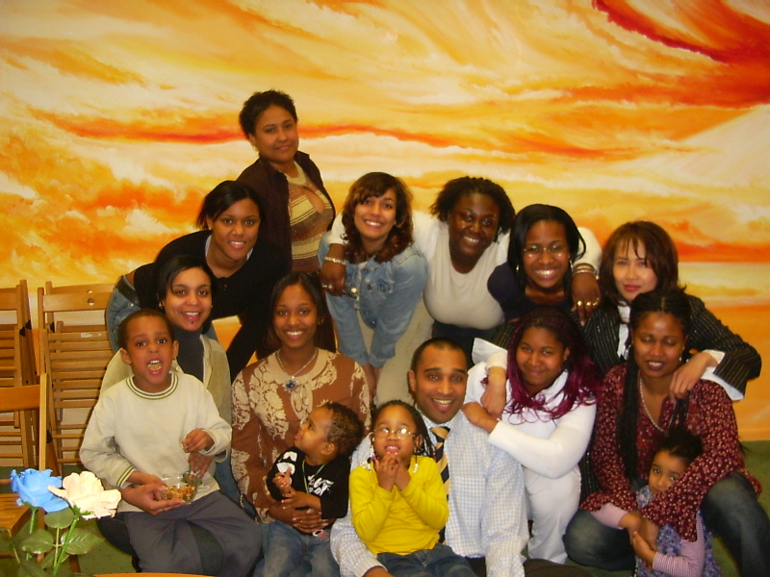
The Way Up developed on the basis of a pilot teenage mother group

Slide 14
CRITERIA THE WAY UP
Realizing social and economical goals
Geared to the perception of young parents and youngsters;
Tapping into market needs
Creating working experience places in several branches
Co-operation with business and industry
Individual coaching and after care

Slide 15
The Way Up has evolved into a place
that serves as a regional centre for social entrepeneurship
that is an creative incubator
where entrepreneurship, learning and working are combined in an innovative way.
where entrepreneurs are being facilitated
that offers starting entrepreneurs specific services.
where young creative starting entrepreneurs can start very accessible.
that reserves 40% of the space for young creative entrepreneurs
that offers affordable space which can be rented from 1 hour to 2 years.

Slide 16
Trainingscentre:
traject The Manager in me (MIM)
Working experience enterprise offering working experience places
for young parents and youngsters.
Test business centre for young starting entrepeneurs
THE WAY UP

Slide 17
Organizational structure The Way Up
Foundation VON
Working experience enterprise
Business centre
Test business
Partners
Creative incubator

Slide 18
Working experience enterprise The Way Up
Knowledge centres for vocational education
Educational manager The Way Up
trainees facility
hospitality
Partners educational institutions
Practice supervisors
trainees event organising
trainees ICT, multimedia, administratie

Slide 19
Test business centre
Guiding 20 young starting entrepreneurs
Co-operation with the corporate world
Individual coaching and aftercare
Business coaching

Slide 20
Partners
Education institutions
Government
Corporate world
Local companies
Social organizations
Regional organizations
European organizations

Slide 21
Thank you for youre attention!

