Slide 1
Stephen Long & Sandra McCarry
I am Roma
Belfast Inclusion Project
Notes:
Good afternoon I am Sandra McCarry Senior Manager at BHSCT and Co-ordinator of Belfast Local Action Group:
I am Stephen Long community development worker at BHSCT and I was responsible for the implementation of the Belfast programme

Slide 2
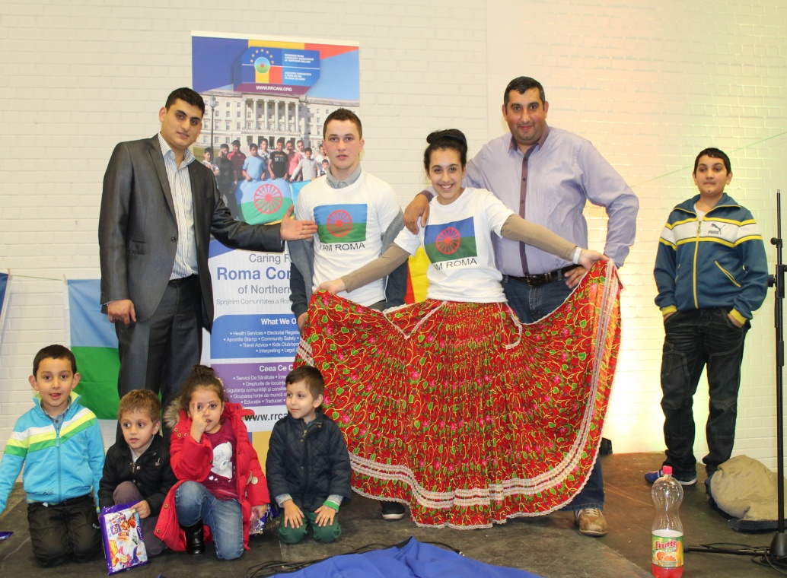
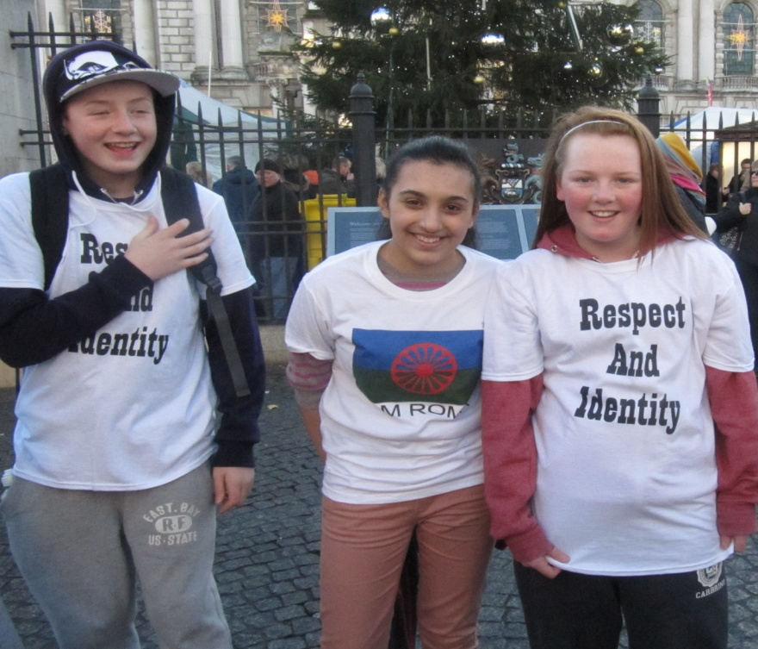
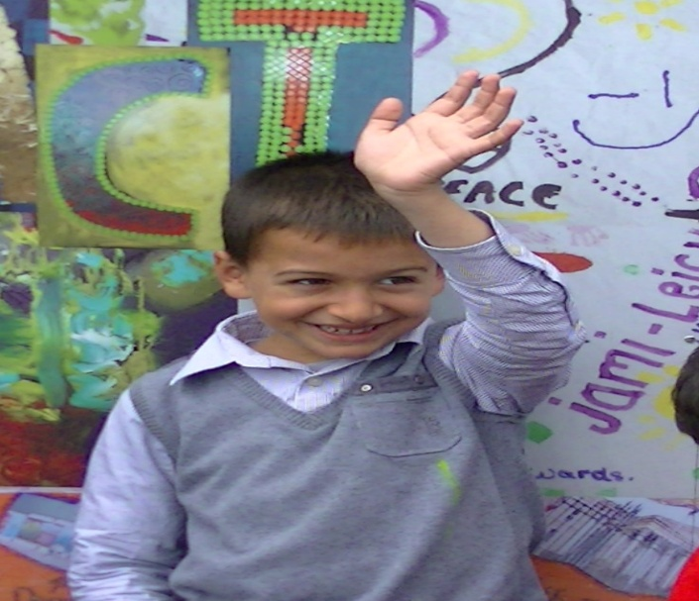
The Roma In Belfast
Notes:
I have to say we know a lot more about the Roma in Belfast that we did at the start of this programme. There are up to 1000 Romanian Roma living in Belfast Approximately 200 of these are children under the age of 16 Years. They mostly reside in the Holylands and Lower Ormeau areas of South Belfast. Relations with these two communities have been good and as you will see later the I am Roma programme has been credited with helping to improve the relationships. attacks on Roma families still happen but is generally when Roma move outside these two areas.
As A2 national their rights are restricted and this compounds their already harsh life in the city.
Roma tend to live in overcrowded privately rented houses, as many as 30 in a house. Being exploited by unscrupulous landlords.
They have restricted access to health care with only free emergency care and this causes particular problems for maternal and child health.
Employment is confined to working in car washes and selling the Big Issue magazine again this leaves the Roma vulnerable to exploitation.
Children must attend school between the ages of 5 years and 16 years and attendance at primary school is usually good, however in post primary attendance dramatically drops and Roma cite bullying as the main reason for this.

Slide 3
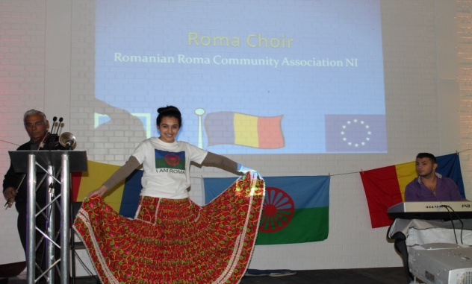
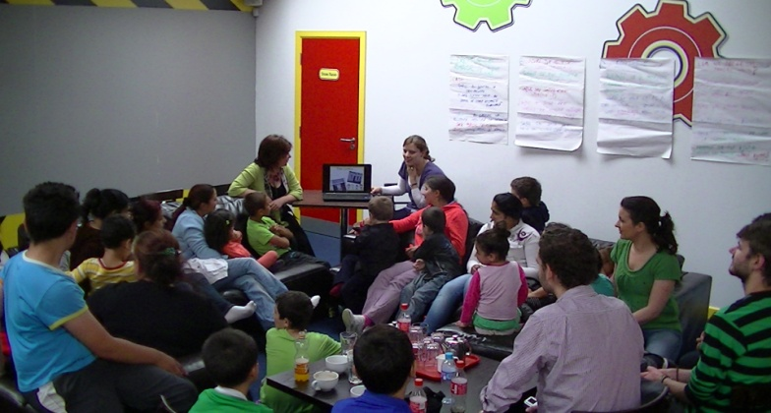
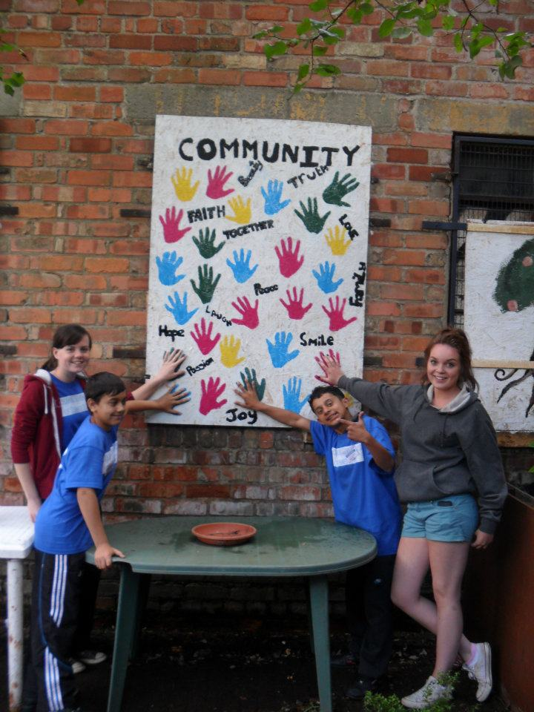
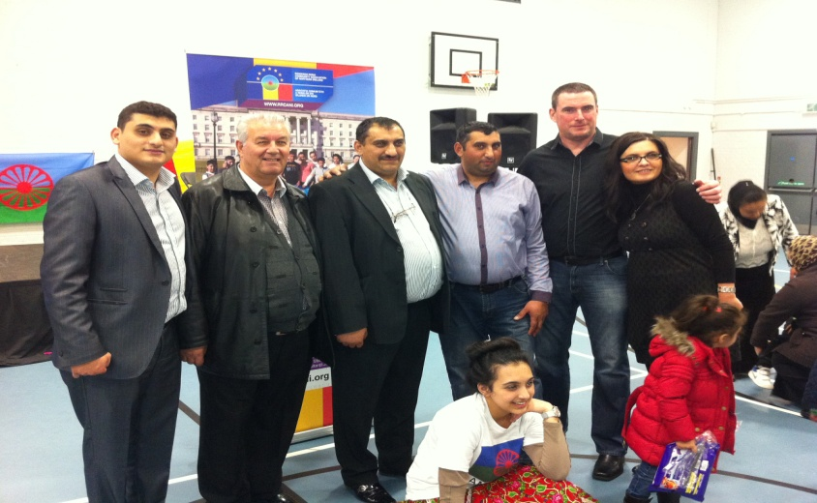
A community Development Approach
Notes:
From the outset the LAG decided to adopt a Community Development approach to our campaign with the Roma. The context of the Roma community in Belfast is different to the other EU partners. Inward migration is relatively new to NI, We had no concept of who the Roma were, where they were living and what their lives were like. we started with the premise that we couldn’t campaign for Roma rights and challenge stereotypes if we didn’t know who the Roma were. We undertook a sustained period of relationship building and then capacity building with the Roma community to develop our programme and campaigns.we are now going to highlight some of the elements of our successful campaign were:

Slide 4
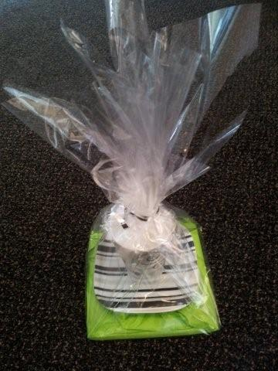
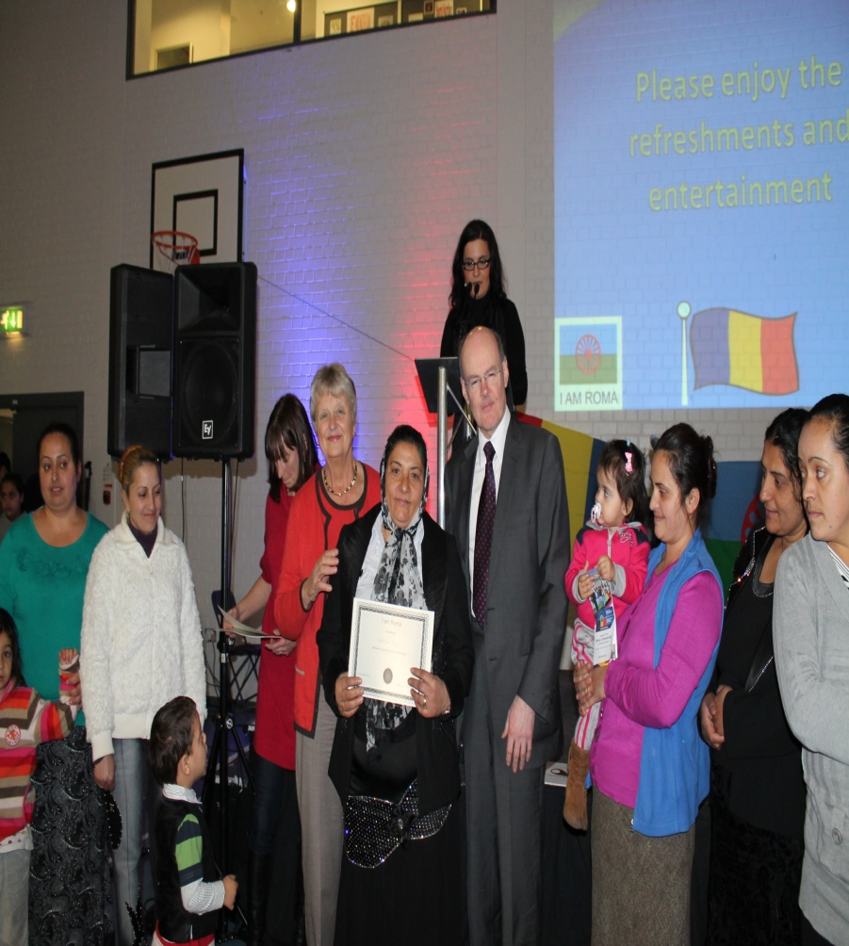
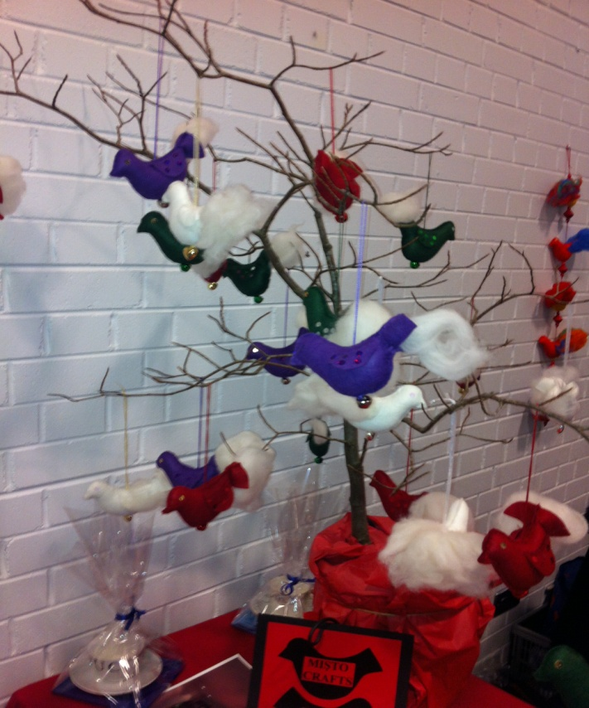
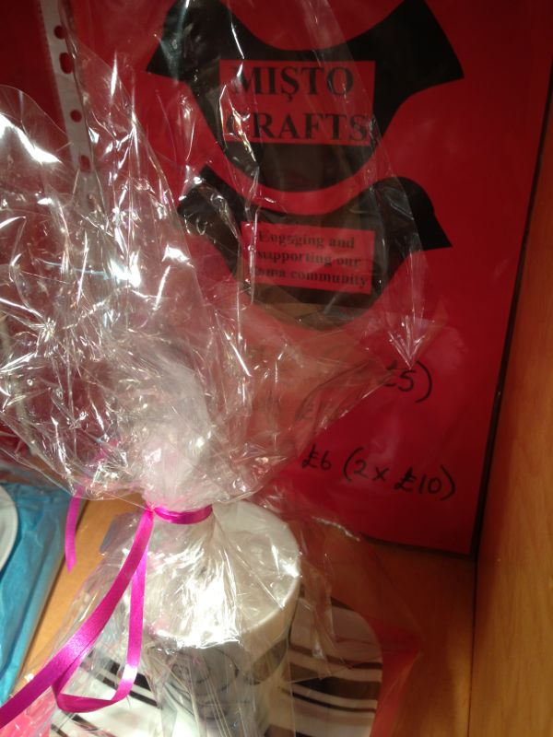
Social Economy
Notes:
A key factor in enhancing Roma women’s emancipation is of course economic empowerment and indeed economic independence. This aspect of the programme recognized and confronted the challenges and barriers that prevent Roma women taking part effectively in economic life. Some of the product made by the Roma women is on display here today. We had 24 Roma women involved over a 3 month period, making and selling their goods. The central picture is the Romanian Consul to NI and the Chair person of BCC Good Relations Committee handing out certificates to the participants at our celebration event. Luckily this part of the programme was very successful and funding has been secured to continue this.

Slide 5
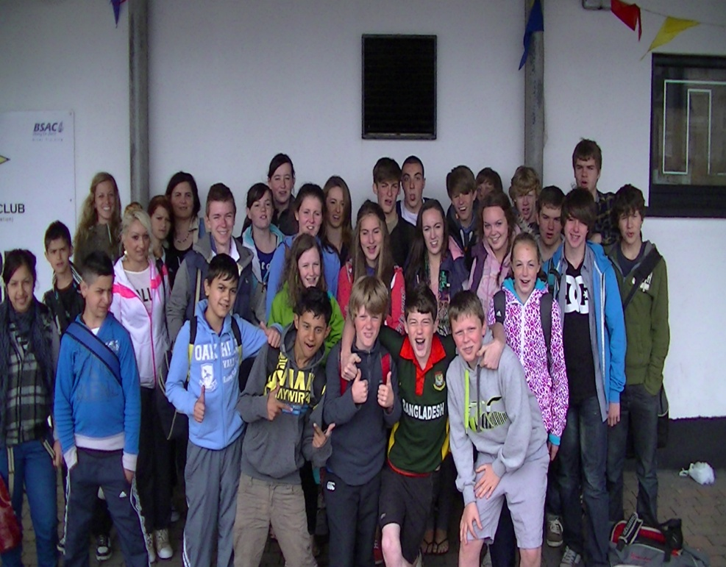
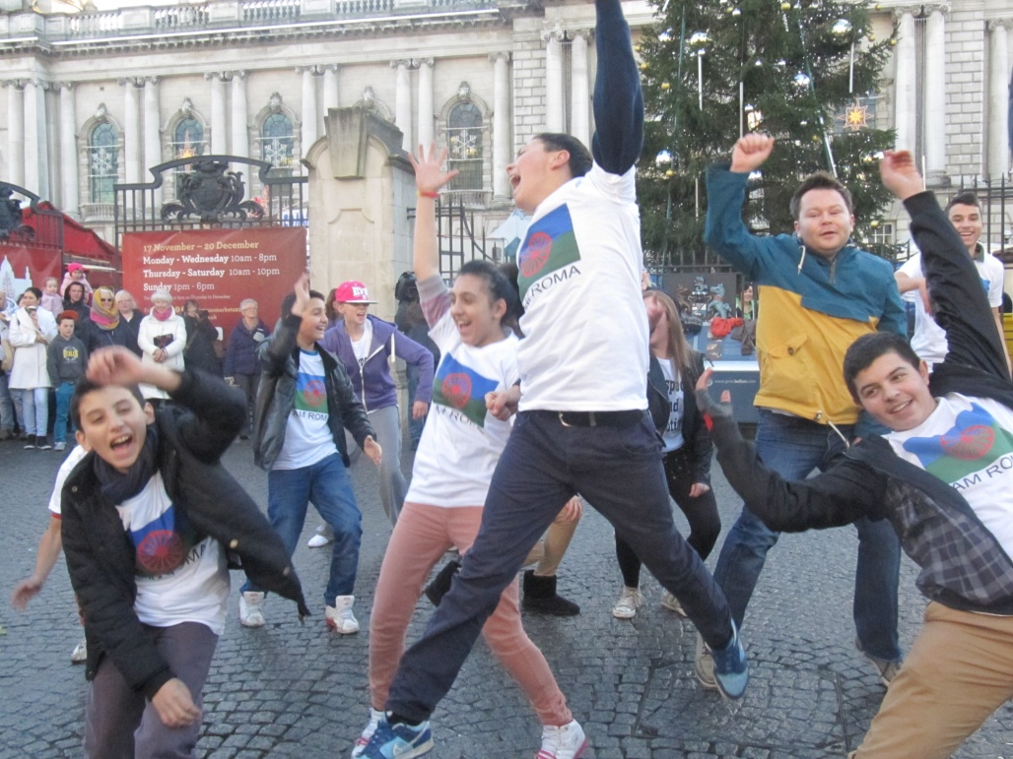
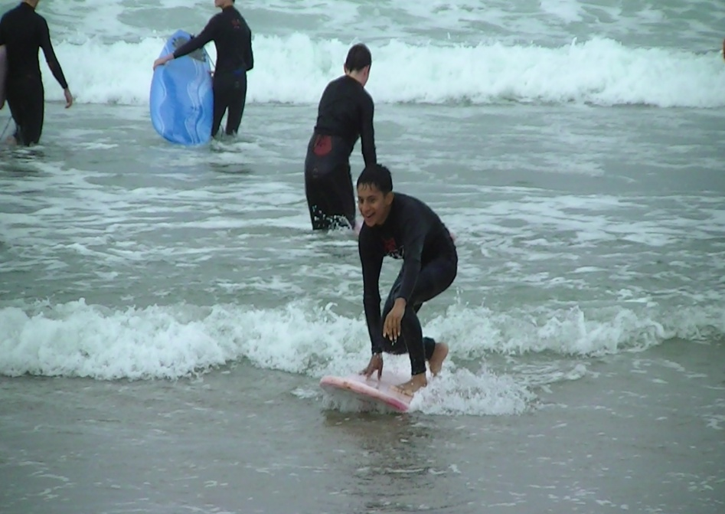
Youth Integration
Notes:
We are now going to show you a short DVD on our youth programmes.

Slide 6
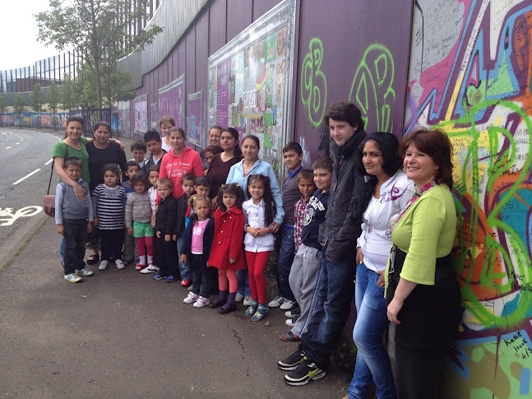
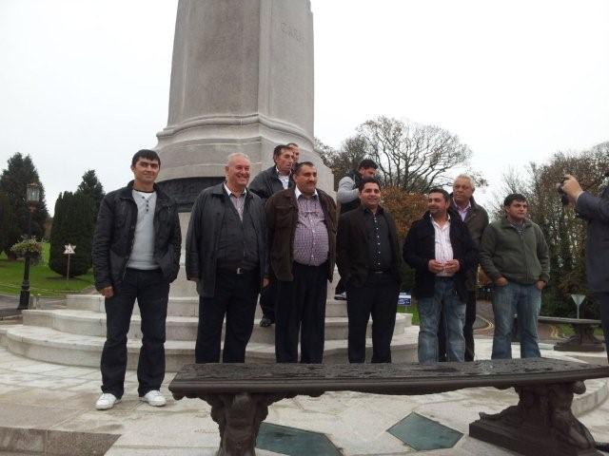
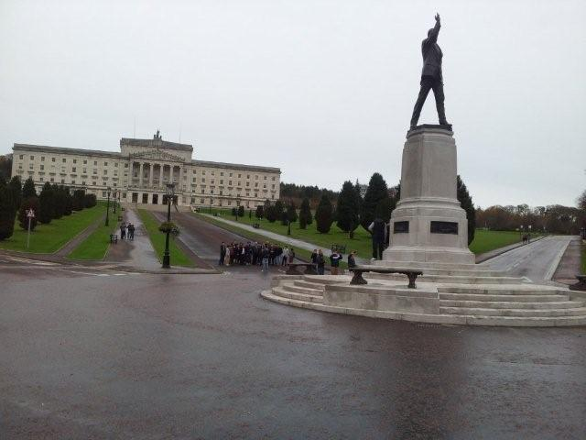
Orientation to Belfast “know your Rights”
Notes:
The Know you Rights and Orientation in Belfast sessions were carried out simultaneously. Over Ninety members of the Roma community (including heads of families) attended at least two sessions at which the participants were given basic information about the EU legislation for A2 nationals, local cultural norms, expectations and responsibilities for the newcomers in Belfast. Section 75 of the NI act was also highlighted.
The pictures show Roma women and children at the “peace line” in Belfast and the Male heads of family at Stormont Building the seat of the NI Government

Slide 7
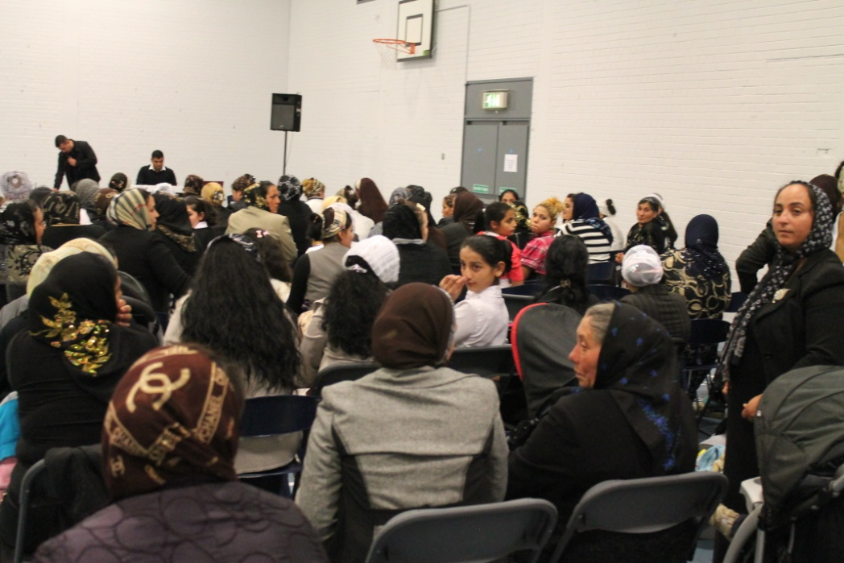
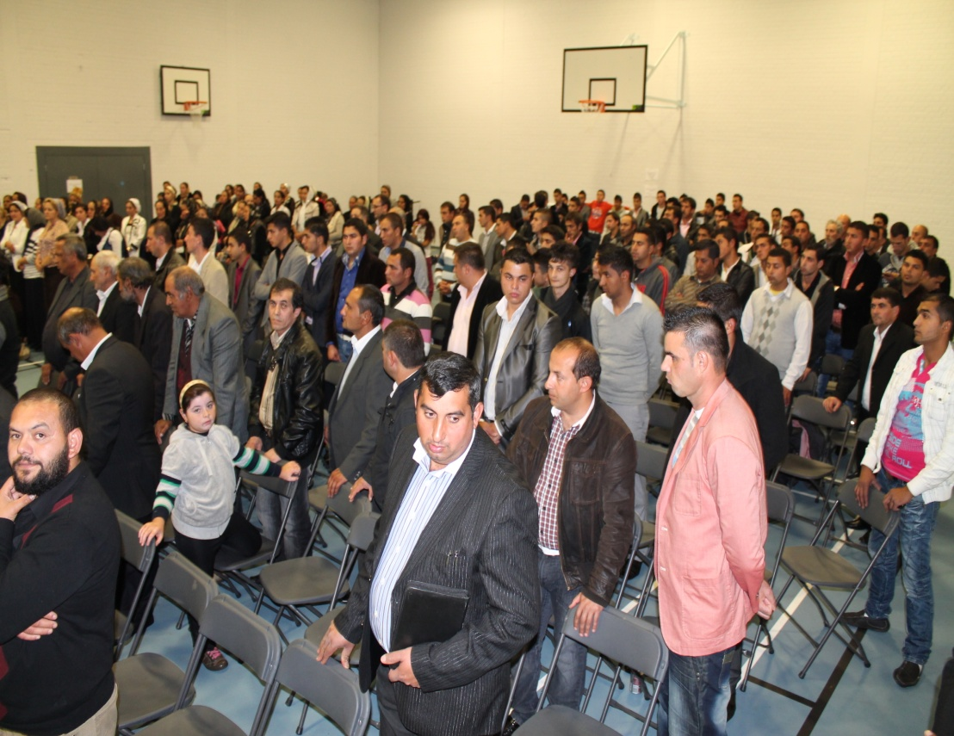
Living in Northern Ireland
Notes:
As part of our campaign we produced a 30 minute DVD in Romanian welcoming Roma to Belfast and to inform them of the rights and responsibilities as citizens out the city. The film was premiered at the Roma church and a copy delivered to every Roma family in Belfast. We are now going to show a short promotional clip of the DVD which is in English

Slide 8
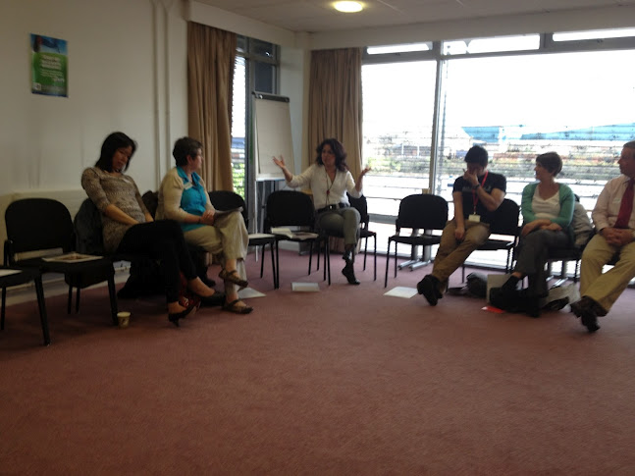
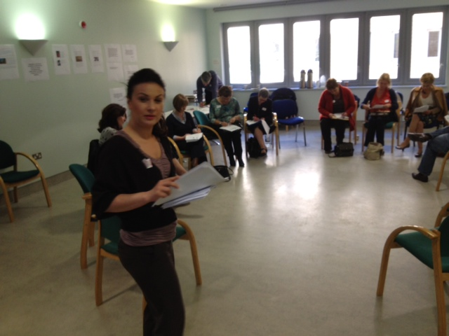
Capacity Building in Statutory Organisations
Notes:
The rights of all ethnic minorities are protected under law in NI and equality and human rights training are mandatory in most Governmental organisation. Specific training on Roma culture and traditions was developed and delivered across a wide range of organisations. Over 3000 language cards were produced and 2000 leaflets entitled “ Working with Roma; Myths and Realities” were distributed to frontline staff.

Slide 9
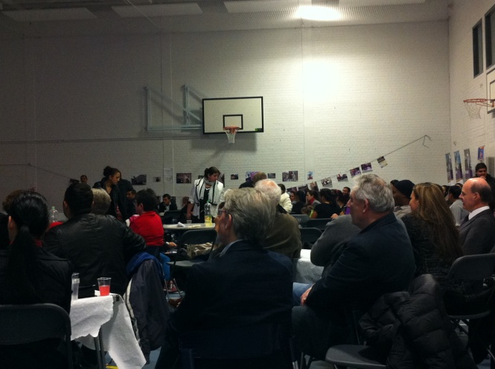
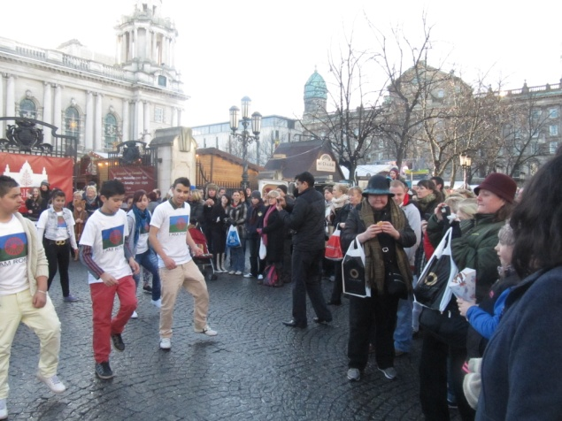
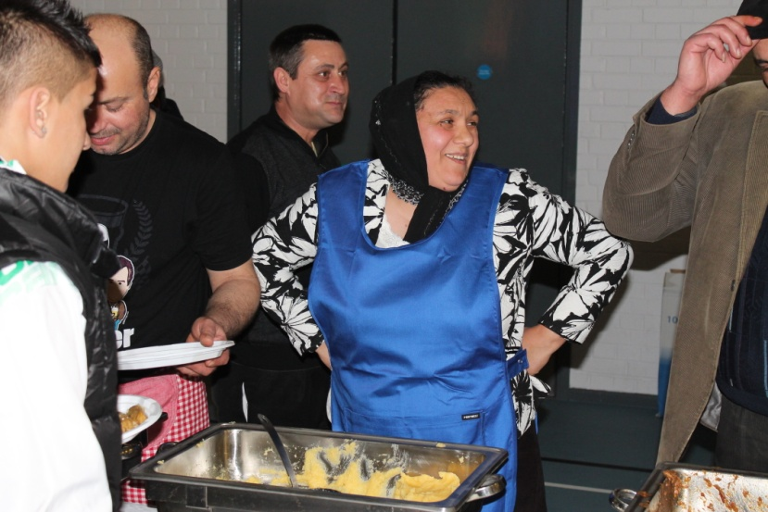
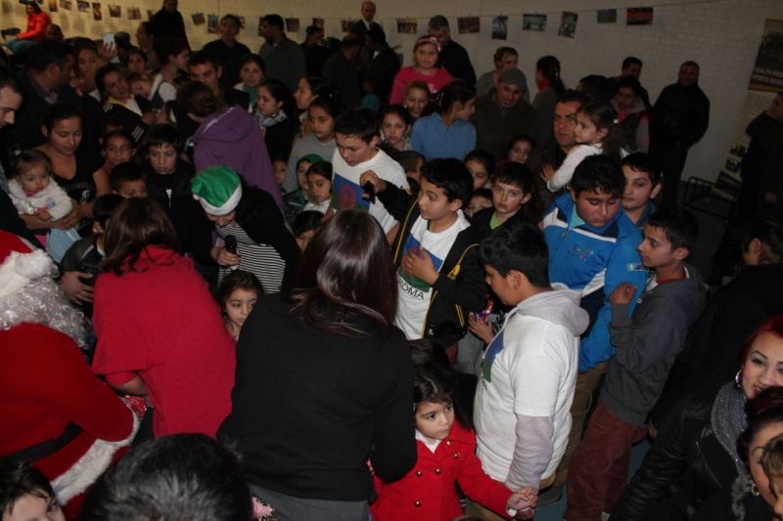
Celebration of Roma
Notes:
A celebration of I am Roma was held on Romanian National day, the day commenced with the “flashmob” at Belfast City Hall with over 30 participants and 200 spectators. Later that evening over 300 Roma and special guests attended a celebration in a local community centre. The event was addressed by the chair of the Belfast City Council Good Relation Committee and the Chair of RRCANI. Both she and the Romanian Consul to NI presented certificates to the youth programme and social economy participants. Music was provided by Roma musicians and a Roma choir but the highlight of the night was the appearance of Santa Claus who gave presents to over 100 children.

Slide 10
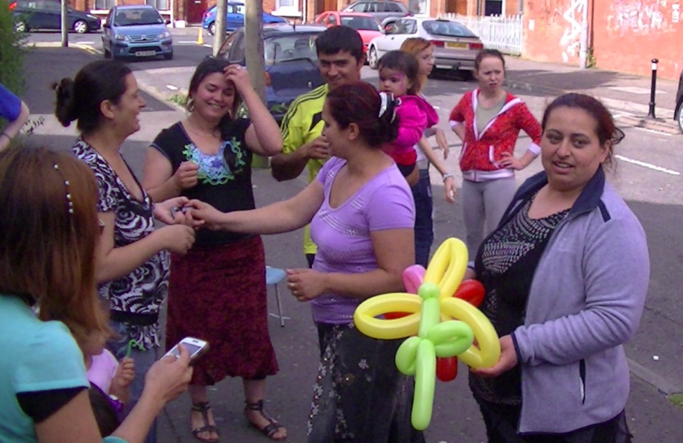
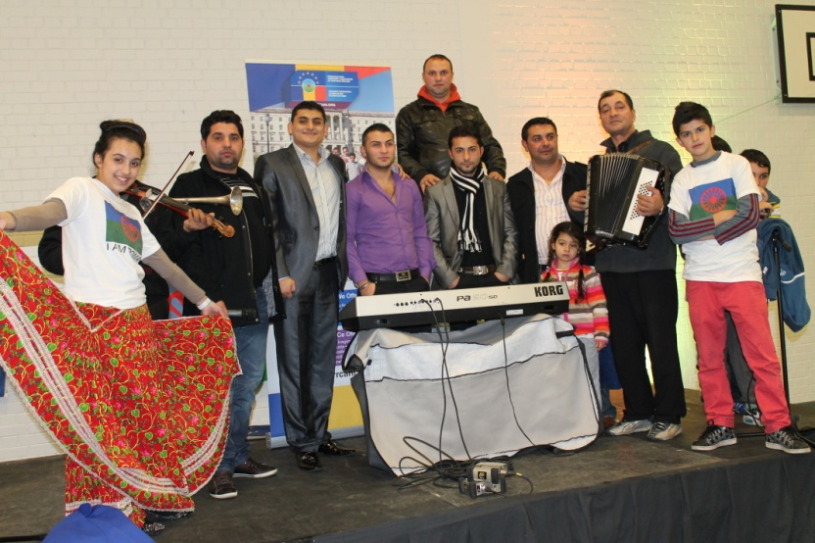
The Legacy of I am Roma
The local community a year ago would have been hostile – but the same levels of hostility wouldn’t be there now – lots of myths are being broken down and the Roma have adjusted their behaviour also...
Notes:
one of our Partners stated this in the project evaluation and it probably sums up the success of the project, yes we have achieved moderate success in local communities and larger organisations in challenging myths and breaking down stereotypes to the extent that the Roma now feel more welcome in host communities. Roma are now beginning to interact and work with statutory agencies. They are more confident and unified and have strong support organisation and key advocates.
Organisations have adapted their policies and procedures to ensure that they meet the needs of the Roma in a culturally sensitive manner and they are beginning the process of preparing for 2014 now. While a political and policy vacuum remains there are encouraging signs that the I am Roma programme has impacted upon this with OFMDFM Racial Equality Unit recently appointing a worker to deal with Roma at a policy level. The new racial equality strategy for NI will also include specific reference to Roma. A Health Visiting Service for Roma has been established and a consultant led paediatric clinic for Roma children is being piloted at the minute. A concerted lobby is in place to get Roma full access to health care and test cases are imminent.
Much has been achieved with very little resource, a dedicated cohort Roma advocates from across all sectors has been established. The question these people and the Roma community are asking is where do we go from here

