Slide 1
I am Roma “Developing local campaigns to challenge negative stereotypes” Final Meeting Date: 28-30 January 2013
I am Roma project, implemented in Romania by Romani CRISS

Slide 2
“Declare your ethnicity at the census openly!”
The official census of population and households was held from 20th to 31st October 2011, in Romania, 10 years after the one before it
According to the 2002 official date, 535,140 Romanian citizens declared themselves as Roma ethnics
According to the European Commission’s and other nongovernmental organisations’ research, the real number of Roma people living in Romania varies between 1.5 and 2 million persons.
In order to increase the accuracy of census data related to ethnicity, Romani CRISS implemented the “Declare your ethnicity at the census openly” campaign
At the 2012 census, the number of people to declare themselves Roma was 619,007, thus an increase of approximately 20%.

Slide 3
“Declare your ethnicity at the census openly!”
Activities of the campaign
Raising awareness campaign targeting Roma population in regard to the census, its importance and self-declaration of Roma ethnicity
Meetings with public authorities
Video messages
“Roma Pride” March

Slide 4
“Declare your ethnicity at the census openly!”
Localities where the campaign took place
Homorod and Apata, in Brasov county,
Valea Teilor and Babadag, in Tulcea county,
Constanta, in Constanta county,
Dolhasca, in Suceava county,
Haghig, in Covasna county,
Petrosani, in Hunedoara county,
Craiova, in Dolj county,
Bucuresti and Ilfov county.
Several information visits took place in each of the localities, starting with May to October 2011. It included “door to door” activities and events, distribution of materials with the campaign message – including images of famous Roma: Doinita Oancea (Roma actress) and Jean Dumitrache (Jean de la Craiova – Roma singer): 8850 informative materials (1000 posters, 4000 flyers, 800 t-shirts, 50 headscarves, 1000 cups, 1000 magnets).

Slide 5
“Anti-discrimination campaign”
Flash mob
On October 22nd, Romani CRISS organised a flash mob against discrimination, with the participation of well known actors (Roma and non-Roma) and public personalities that prepared and rehearsed a choreography on a Roma song - http://www.youtube.com/watch?v=-m3uFpTjLps&list=UU79dS-YvaaXrd6oiO-RZt_g&index=3&feature=plcp
The people participant at the event included actors Doinita Oancea, Ionut Ghenu, Carmen Tanase, Majda Aboulumosha, Catalin Ciurdar, Madalin Mandin
They also recorded message about non-discrimination and supporting Roma identityhttp://www.youtube.com/watch?v=Wzsm-Df2ehg&list=UU79dS-YvaaXrd6oiO-RZt_g&index=1&feature=plcp
http://www.youtube.com/watch?v=Slrc88GlzlQ&list=UU79dS-YvaaXrd6oiO-RZt_g&index=1&feature=plcp
http://www.youtube.com/watch?v=-V-s3m8StPw&feature=autoplay&list=UU79dS-YvaaXrd6oiO-RZt_g&lf=plcp&playnext=1
http://www.youtube.com/watch?v=yKSHNh3AZH4&list=UU79dS-YvaaXrd6oiO-RZt_g&index=4&feature=plcp

Slide 6
“Anti-discrimination campaign”

Slide 7
“Anti-discrimination campaign”

Slide 8
“Anti-discrimination campaign”
Roma Pride March
On October 1, 2011, Romani CRISS organized the „Me sem rom, me sem romni – I am Roma man, I am Roma woman” Roma Pride in Bucharest.
Over 500 people across the country (from Brasov, Braila, Cluj, Constanta, Dolj, Galati, Giurgiu, Iasi, Ialomita, Salaj, Tulcea, Vrancea counties) participated
Other NGOs joined Romani CRISS in organising the event: O Del Amenca association, Eltera Association, Florists Association in Romania, Gypsy Eye organisation, Roma Journalists Association, Romano Butiq Association, Romano Suno Association, Sanse Egale Association, Centre for Counseling and Social Inclusion – Xoraxaj, Roma Youth for Unity, Health Mediators Association – Zurale Romnia.

Slide 9
“Anti-discrimination campaign”
Roma Pride March
Roma from different lineages participated, traditional and non-traditional, adults and children, Roma and non-Roma
The participants chose different ways to express their identity: a flash mob by Gypsy eye, short speeches, the Roma hymn sung, an artistic moment supported by Turkish Roma in Babadag
The international artist Vadim Kolpakov, from Via Romen band in USA recorded a video message on this occasion, where he supports the involvement of children in asserting identity: „children should know more about Roma history and contribution in order to be proud”. Vadim Kolpakov video message
http://www.youtube.com/watch?v=dTHwKg7omwE&list=UU79dS-YvaaXrd6oiO-RZt_g&index=9&feature=plcp

Slide 10
“Anti-discrimination campaign”
Roma Pride March
The well known philanthropist George Soros also supported the march and it message:
http://www.youtube.com/watch?v=dTHwKg7omwE&list=UU79dS-YvaaXrd6oiO-RZt_g&index=9&feature=plcp
The US Ambassador in Romania sent a letter of support
“The dignity march is a great way to show pride as the Roma community. Roma should be celebrated for their unique cultural history and at the same time embraced as equal and full members of Romanian society. It is important for all Romanians to value Roma traditions, and to realize that this is a multiethnic country. All minorities, including the Roma, are important parts of modern Romanian culture [...] For all the participants today, I encourage you to be proud of your heritage and to be proud of your Roma friends. Teach tolerance to your children and when you hear discrimination around you, speak out against it to create a more tolerant country. Slowly but surely, Romania can become a welcoming home for all its minorities.”

Slide 11
“Anti-discrimination campaign”

Slide 12
“Anti-discrimination campaign”

Slide 13
“Anti-discrimination campaign”

Slide 14
Capacity building program
An expert was contracted to draft a concept and an agenda for the capacity building program, which took place starting with December 11, until December 16 2011, around the International human Rights Day. The capacity building program was entitled the Human Rights Academy, and it was organized in partnership with Amnesty International, the strategic partner of Romani CRISS and FXB Center for Health and Human Rights – Harvard University.

Slide 15
Capacity building program
Subjects discussed within the Academy:
Roma History
Social gap and lack of access to services, caused by their statute
Early marriages
Campaigning
Basic principles of strategic campaigning
Identifying the target groups of the campaign
Planning the influence channels
Right to Health
What are rights? What is the right to health?
Values and mechanisms of the right to health
Health and the Roma community
History and implementation of advocacy actions in the field of health for the Roma communities

Slide 16
Capacity building program
Subjects discussed within the Academy:
Case studies
- Health mediation program
Segregation of the Roma in hospitals
Double discrimination of Roma women
Gender equality
Gender identity in the context of other identities
Gender discrimination
Intersectional and integrated approach of gender
Stereotypes and prejudices on Roma.
Prejudices, stereotypes, discrimination – differences
Discrimination against Roma
Discussing stereotypes against Roma in Romania
Ways to build the pride of being Roma in Romania

Slide 17
Capacity building program
Subjects discussed within the Academy:
National legislation
Discrimination – notion
National Council for Combating Discrimination – structure and activity
Procedure of solving petitions of the NCCD
International systems of protecting human rights
Mechanisms of activating international legislation on human rights
What can national organizations do in relation with international bodies
School segregation of Roma children
Short history/evolution of the segregation concept as a specific type of discrimination
Debate: residential segregation – intercultural magnet schools;

Slide 18
Capacity building program
Other activities within the Academy:
- The participants attended a debate within the Romanian Parliament, on the speech of politicians targeting Roma
They also attended a videoconference, hosted by the US Embassy, with reverend Elbert Ransom, former assistant of Martin Luther King
Intercultural evening
Film screening (on human rights topics)

Slide 19
Capacity building program
Follow-up:
- The participants will be involved in volunteering actions for the benefit of the Roma communities
Romani CRISS intends to organize the Academy annually
Participants of the Academy – 2011 edition will attend the future editions as alumni

Slide 20
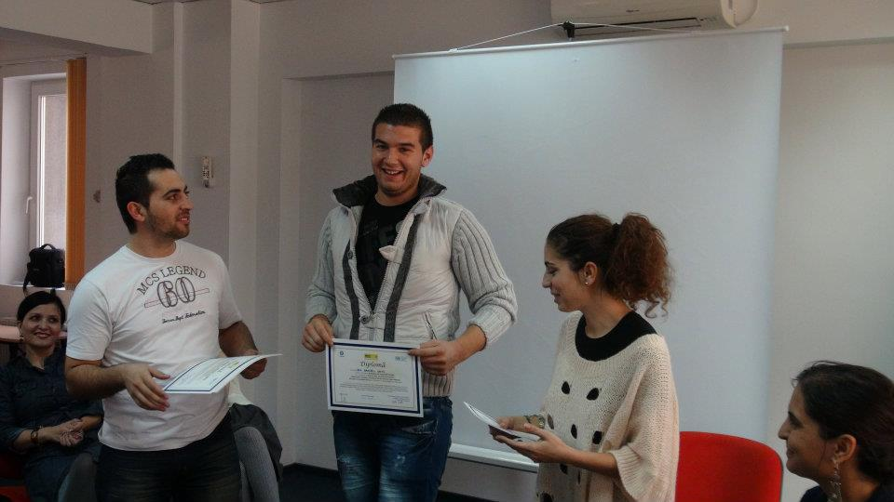
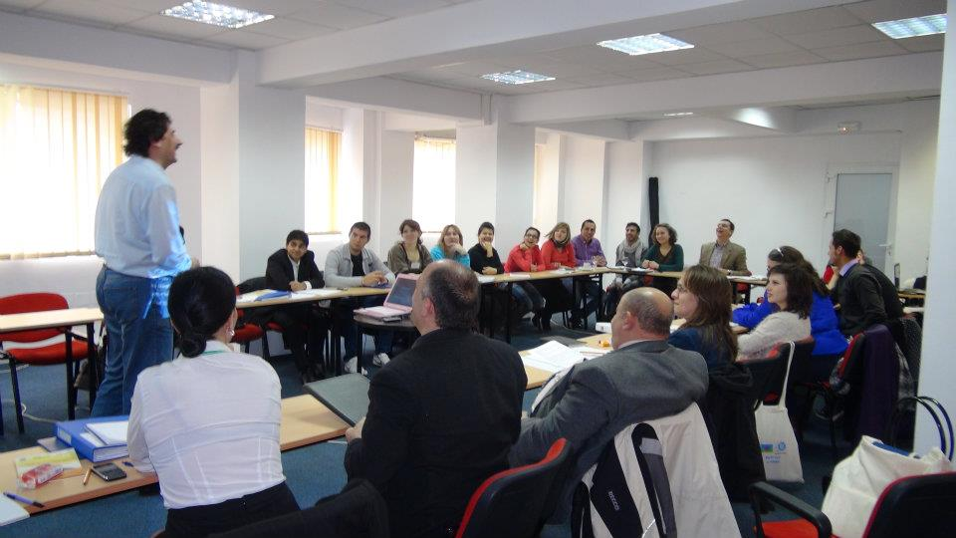
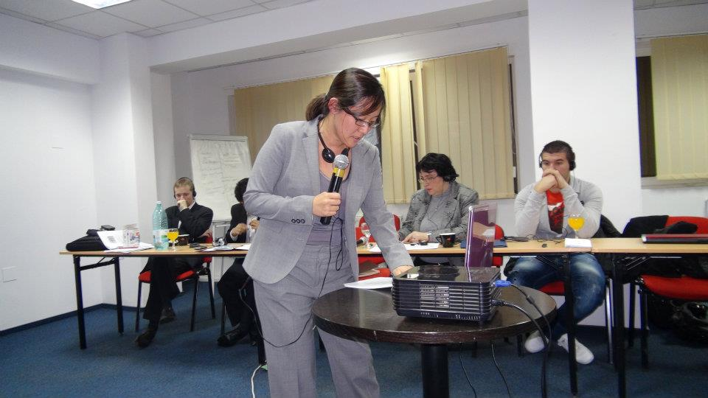
Capacity building program

Slide 21
Café style event
Commemoration of Roma victims of Holocaust, 2nd of August
The event gathered 50 people (mainly Roma young people, enrolled in high schools, beneficiaries of Romani CRISS programs).
It was organized at the Memorial of the Holocaust Victims in Romania.
One organization and two institutions have supported the event: National Centre for Roma Culture – Romano Kher, the National Institute for Holocaust Studies “Elie Wiesel” and the Centre for Monitoring and Combating Anti-Semitism
After the commemoration, a cafe-style event was organized. The participants have watched a film on the Holocaust thematic, which was followed by discussions on similarities to current issues, impact of the history on the Roma communities, stigma and discrimination.

Slide 22
Café style event

Slide 23
Café style event

Slide 24
Café style event

Slide 25
Media coverage
Press releases launched:
On the occasion of the Roma march;
On the occasion of the Human Rights week (HR Academy);
On the occasion of the café style event

Slide 26
Media coverage
The press has covered the flash mob, mostly, due to the public figures involvement. 20 Romanian online publications mentioned about the flash mob and its purpose.
The blog Roma Transitions describes the whole event, making the flash mob video accessible as well:
http://www.romatransitions.org/in-bucharest-a-flash-mob-against-discrimination/
Roma React blog describes the commemoration event (café style event) organized by Romani CRISS:
http://www.romareact.org/reports/view/81

Slide 27
Media coverage
Press conference
The Human Rights Academy had an official opening, during a press conference. The press conference was announced as being part of the Human Rights Week actions, on the occasion of the International Human Rights Day, 10th of December.

Slide 28
Media coverage

Slide 29
Conclusions
The initiative was very successful in Romania.
The activities impacted directly the Roma beneficiaries: in the Roma communities where the campaigns on declaring the ethnic identity within the census the number of Roma assuming their ethnicity in front of the enumerators was 111% higher compared to the results from the most recent census. Further, the beneficiaries of the capacity building program, according to the evaluation of the program, found the information and the methods used very resourceful and useful for their activities and work in the Roma communities. The campaign for changing the perception of the majority population with regard to the Roma is part of a larger perspective and actions CRISS needs to conduct continuously, but represented a very creative start for this type of campaigns.

