Slide 1
Web Observatory & review for discrimination alerts & stereotypes deconstruction

Slide 2
CONTENT
1. Background of the action
1.1. About I.I.T.
1.2. I.I.T. and Roma
1.3. Premises
1.4. Some time ago…
2. About the project
3. About the media campaign
4. Educational aspects of the project
5. Practical examples
6. Conclusions

Slide 3
I. BACKGROUND OF THE ACTION
1.1. About I.I.T.
1.2. I.I.T. and Roma
1.3. Premises
1.4. Some time ago…

Slide 4
1.1. About I.I.T.
The Intercultural Institute Timisoara (I.I.T.) is a non-governmental organization, autonomous and without financial profit, with cultural, civic and scientific activity, without political goals, that accepts and promotes the values and principles of the Council of Europe in the intercultural dimension.
I.I.T. was established in 1992, with the support of local authorities from Timisoara and the Council of Europe. I.I.T. pursues the development of the intercultural dimension in the field of education and culture while promoting at the national and international level the climate of tolerance and dialogue specific to the town of Timisoara. The I.I.T. has established a wide network of partners from all over the world, including institutions, NGOs and professionals from its areas of interest, such as education, culture, youth and minorities.

Slide 5
1.2. I.I.T. and Roma
Several activities developed by the Intercultural Institute Timisoara have been addressing the problems of the Roma communities. The I.I.T. in partnership with several Roma associations from Romania have been engaged in projects targeting the following themes:
education;
capacity building for Roma civil society;
discrimination and stereotypes against Roma;
the Roma image in mass-media;
strengthening the dialogue between Roma communities and public authorities.

Slide 6
1.3. Premises
“A journalist must respect the private lives of citizens; he/she shall not use methods that are forbidden by law in order to obtain information or pictures of people.
When the private behavior of public figures might have consequences on society as a whole, this principle of non intrusion into private lives can be ignored.
It is preferable that the under-aged, sick people and the victims of crimes benefit from confidentiality as regards their identity.
Race, nationality, membership of certain minority groups (religious, linguistic, sexual) shall be mentioned only in cases when that information is relevant to the matter at hand.”
Code of Ethics of Romanian Journalists, Article 4

Slide 7
1.4. Some time ago…
…more exactly in 2000, the I.I.T. had a media campaign with the aim of deconstructing the stereotypes against Roma.
Based on the Article 4 from the Code of Ethics of Romanian journalists, the main idea of the actions was to eliminate the unnecessary use of ethnicity, particularly the word “tigani” in articles that describe illegal activities.

Slide 8
2. ABOUT THE PROJECT

Slide 9
The In Other Words project is conceived firstly in connection to the awareness of the role and reality of mass media across Europe, how they influence intolerant behaviors, and how, on the contrary, they may contribute positively in combating discrimination and promoting cultural diversity.
It has been proven that intolerance, racism, xenophobia and other discriminatory attitudes derive from ignorance (lack of direct knowledge or understanding of diversity), prejudice and stereotypes. The in depth awareness of figures, data, cultural backgrounds, scientific findings and social dynamics may help people develop their own opinion, free from prejudice, thus overcome stereotypes and develop a positive attitude towards minorities and groups that are perceived as "different".
The project aims at reacting to the current situation in which the media are vehicles for stereotypes' dissemination and help improve the correctness of media discourse and messages.

Slide 10
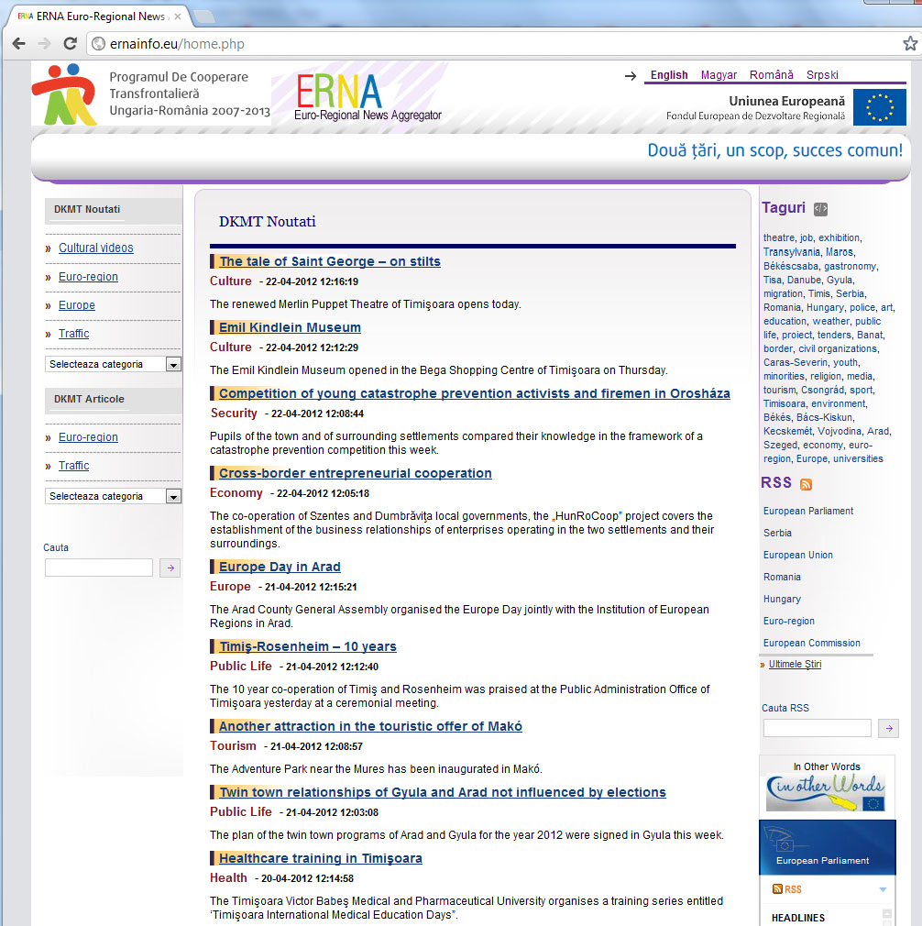
3. About the media campaign

Slide 11
Monitoring the national mass – media (online publications) regarding the articles that explicitly refers to the words “Roma”, “Tigani”.
Analyzing the articles as being “correct/incorrect” and “positive/neutral/negative”.
Re-writing the “incorrect” and “negative” articles.
Transmitting the results to the heads of media publications.
Creating a group of volunteers that will do online activism
Monthly newsletters

Slide 12
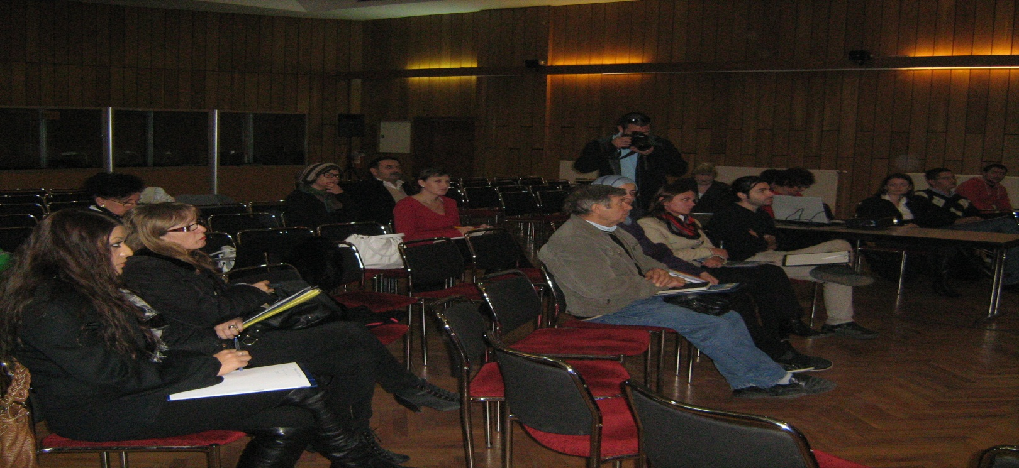
4. Educational aspects of the project

Slide 13
Creating a Local Press Unit with the aim of analyzing and re-writing the “incorrect” and “negative” articles.
Trainings for journalists regarding the deconstruction of stereotypes/discriminatory attitudes against Roma.
Informal meetings with journalists and heads of publications on the topics of Art. 4 and negative attitudes against Roma spread through media articles.

Slide 14
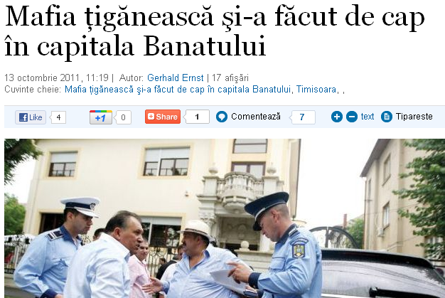
5. Practical examples

Slide 15
6. Conclusions
The mass media has a great potential to fight against Roma stereotypes through the dissemination of accurate information and the use of precise and non-discriminatory language.
The need of journalists to be train and informed about non-discriminatory practices and technics.
In the same time, the general public needs to be trained to apply critical thinking in the relation with media articles.

