Slide 1
I AM ROMA: Changing Mindsets in Prague
Eva Benková 29th January 2013

Slide 2
Outline
Roma minority in Prague
Goals of the I am Roma campaign for children
Evaluation of the I am Roma campaign
Life-long learning of experts
Project team
Conclusion

Slide 3
Roma minority in Prague

Slide 4
The Campaign
children aged 11 – 15 years
lack of information on Roma history and culture

Slide 5
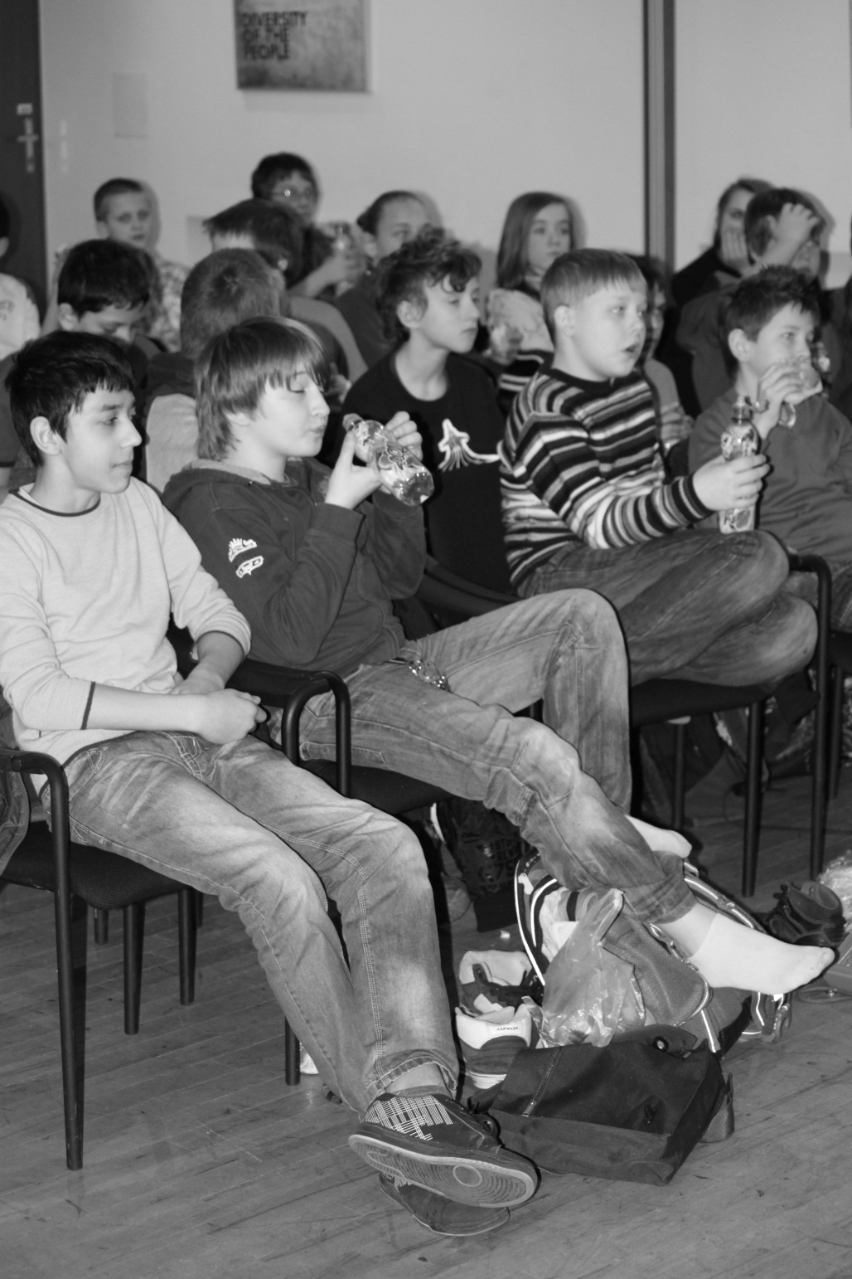
Strategy
Non-formal learning
Participative
Roma and non-Roma children
Positive examples
Make children to think

Slide 6
Teacher: „If Roma children knew more about Roma history, it would definitely contribute to the feeling of being proud of their nationality.“

Slide 7
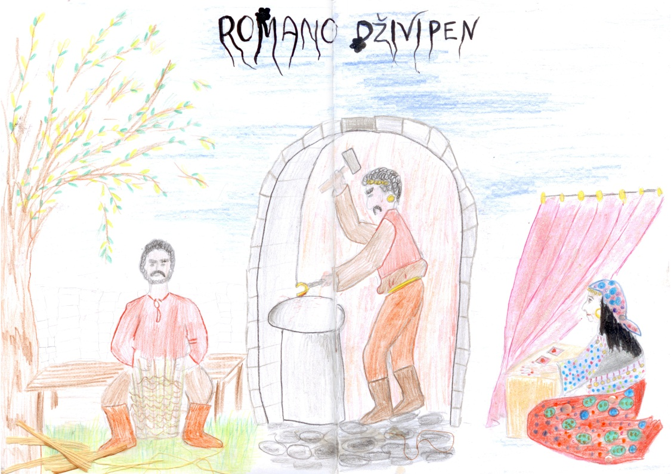
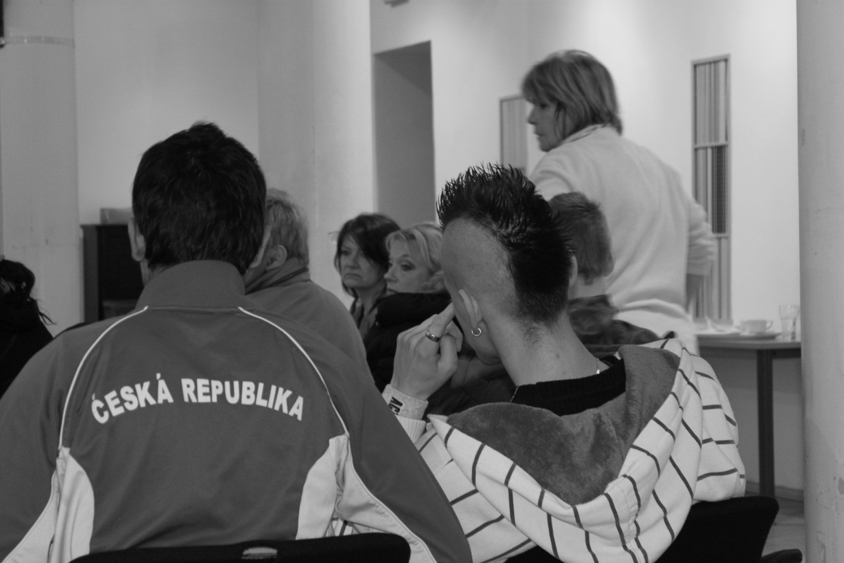
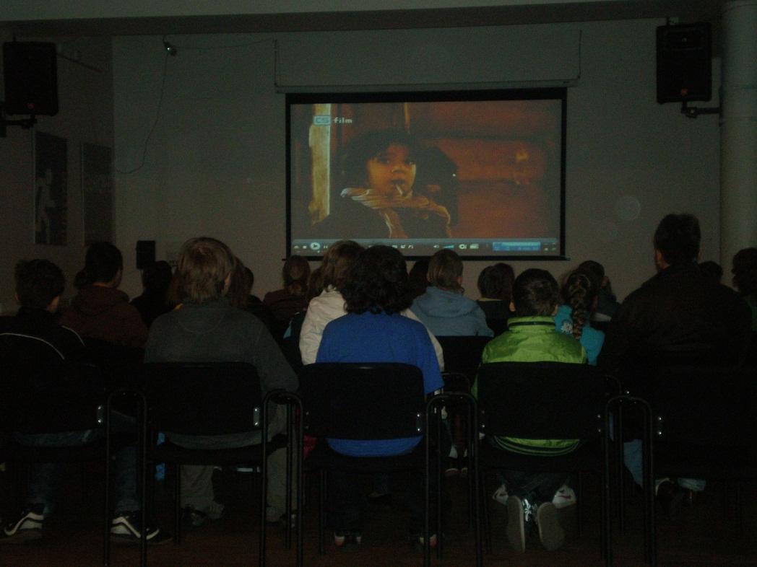
Discussion topics

Slide 8
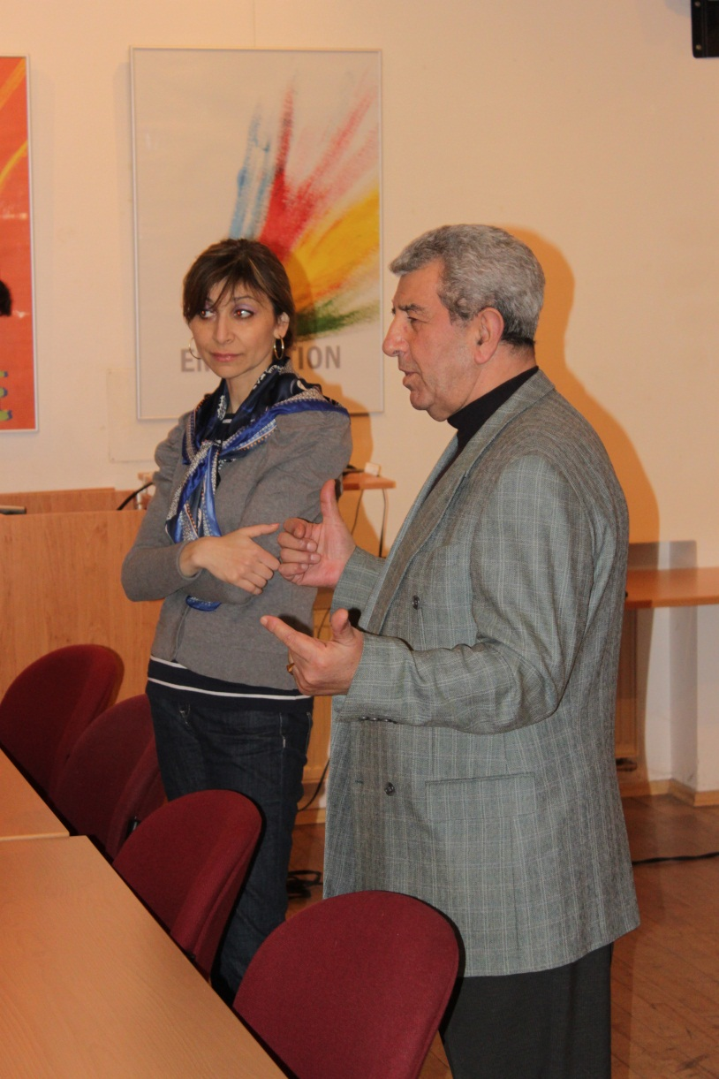
Positive examples
Important for Roma and non-Roma
For both genders

Slide 9
Child: So, what do I think? What do I know?

Slide 10
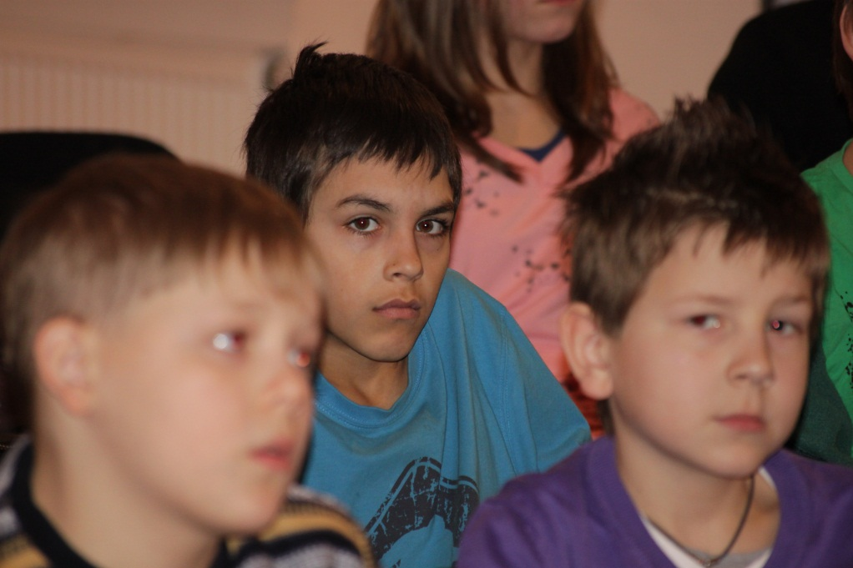
The discussions have continued… even after the end of campaign

Slide 11
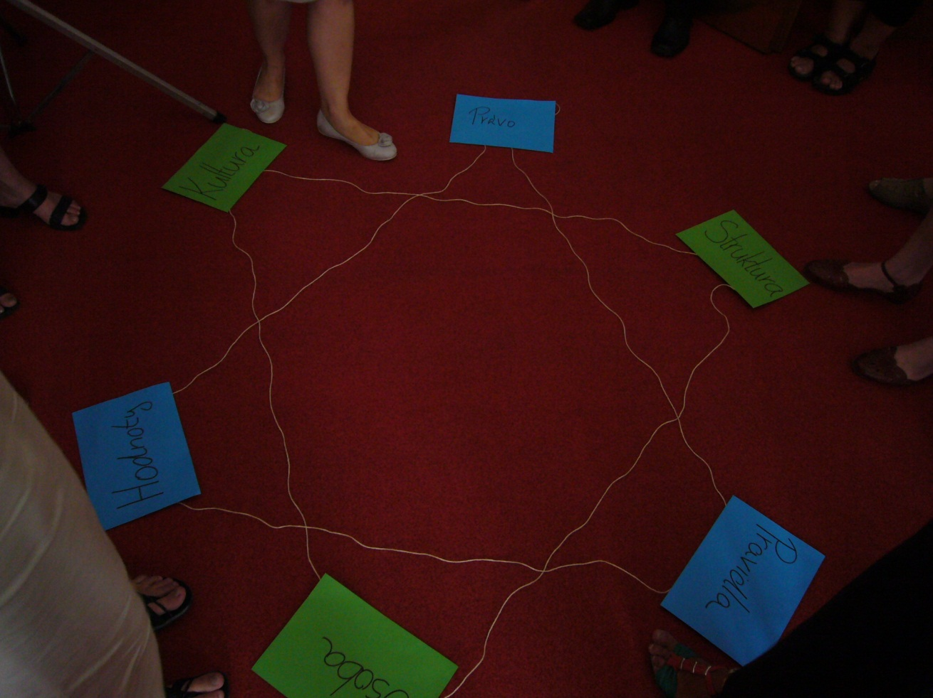
Capacity Building
Capacity Bulding of local Roma coordinators
„We could not
have afforded.“

Slide 12
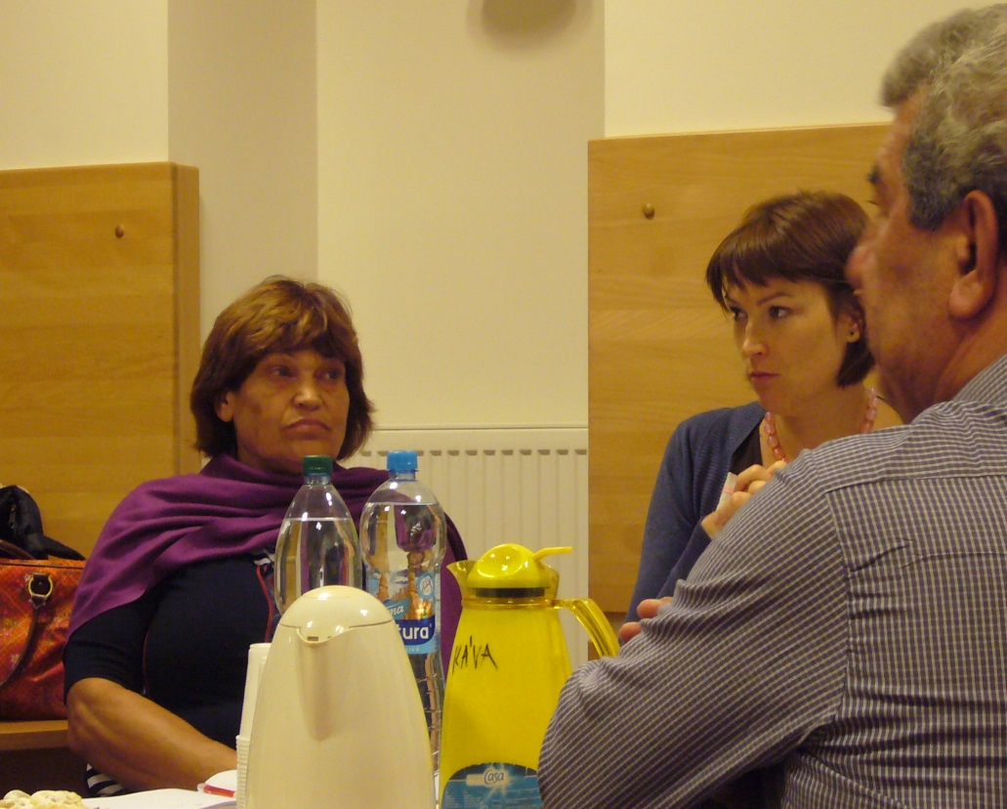
I am Roma Local Action Group
5 : 5
Roma : non-Roma
Different occupations
After the end of project
continue cooperation
continue campaign

Slide 13
Conclusion
Good local action group
Children are the future
Work with teachers
Non-formal learning, experiences
Participative
Final opinion-expression activity for children

Slide 14
Thank you for your attention!

Slide 15
Contact:
European Development Agency, Ltd.
Mgr. Eva Benková. M.S.
Email: eva.benkova@eracr.cz,
evabenkova3@gmail.com
URL: www.euda.eu

