Slide 1
I AM ROMA
Belfast Inclusion Project
GOAL:
To promote social inclusion and address issues of discrimination faced by the Roma community through partnership working to cultivate positive changes in outlook about Roma in Belfast.

Slide 2
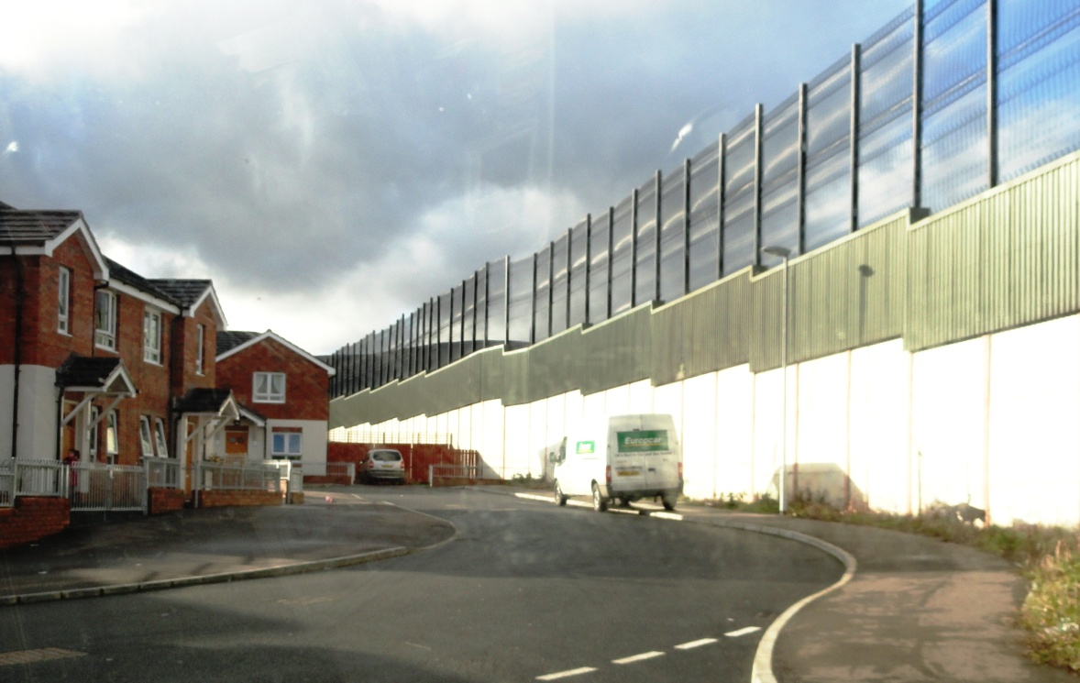
"The Belfast Context",
A Divided City

Slide 3
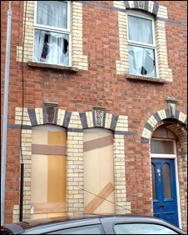
"The Roma experience",

Slide 4
What do we know?
The truth is that initially we knew very little about the Roma in Belfast
Perceptions based on negative media reports
Roma are (understandably) an insular community
Like all communities they have their gate keepers

Slide 5
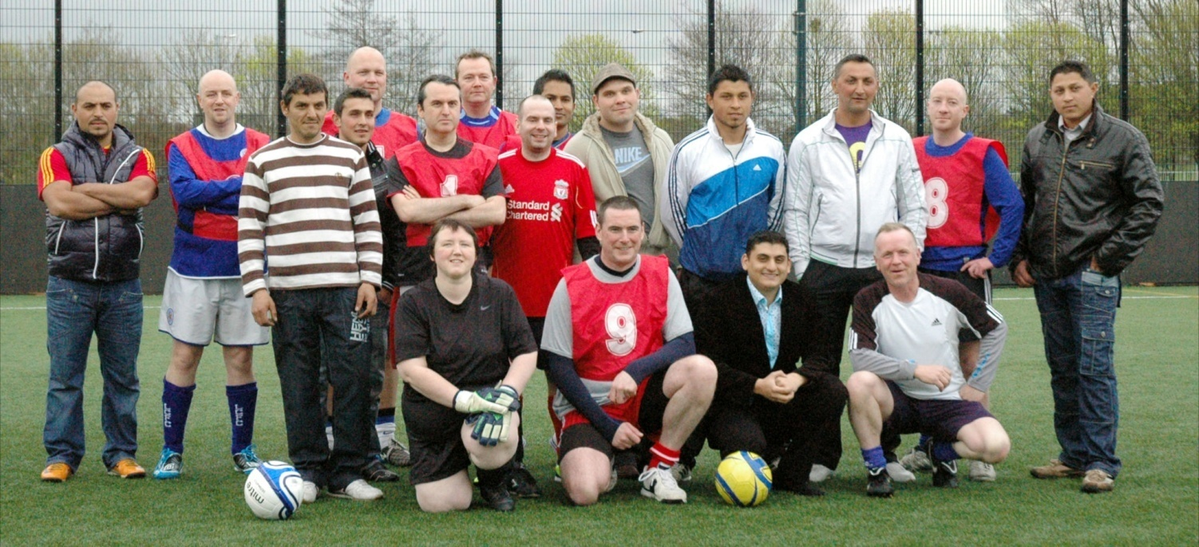
Relationships & Trust

Slide 6
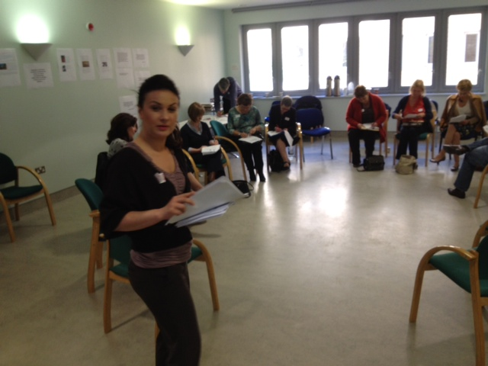
The Plan
To raise awareness of Roma language, culture and traditions and challenge perceptions and stereotyping of Roma
To begin to build the capacity of staff in public, voluntary and community organisations to engage with the Roma

Slide 7
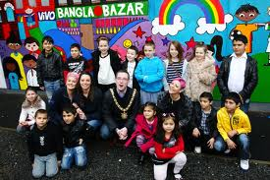
Capacity Building with the Roma
To establish a social economy programme for Roma women
To promote the inclusion of Roma youth with local communities

Slide 8
Progress

Slide 9
Challenges
A group of Romanians who sell newspapers on the streets of Belfast are to appear in court after police seized £24,000 in an anti-crime probe.
"You can't walk into a bank or shop on this road without a Romanian woman shoving a copy of the Big Issue under your nose or begging you for money. I don't mind the Poles and the Slovakians who come here. They work hard, harder than indigenous people from here, but all you see now are these Romanians begging and mooching about. We'd all be better off - them and us - if they went back to Romania or somewhere else in Europe,"

Slide 10
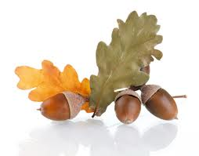
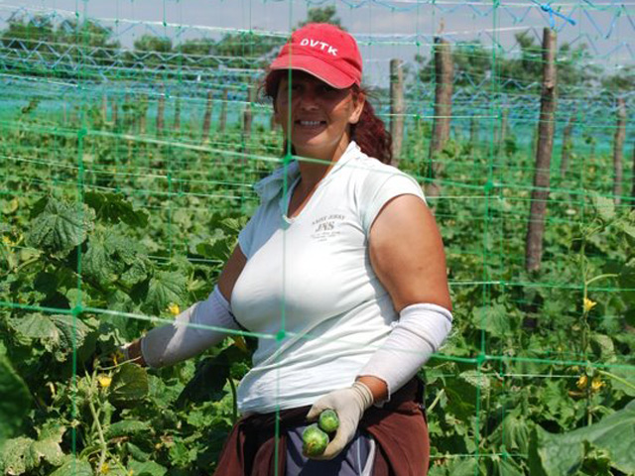
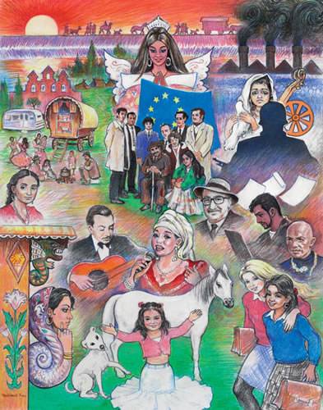
Prospects

Slide 11
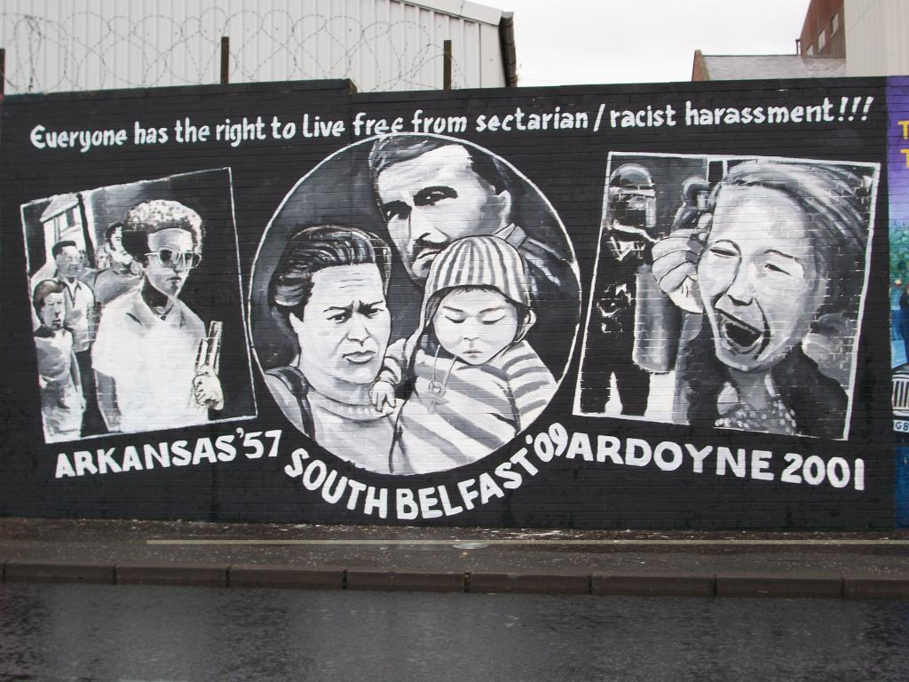
Thank You Sandra McCarry Sorina Toma Stephen Long for info contact stephen.long@belfasttrust.hscni.net

